Slide 1
Dual Circularly Polarizer Waveguide Antenna
Czech Technical University in Prague,
Faculty of Electrical Engineering
Author
Martin Šimák
Supervisor
doc. Ing. Pavel Hazdra, Ph.D.

Slide 2
Outline
Introduction
Polarizer
Feeding structure
Antenna
Final structure
Measurement
Conclusion
Reaction to opponent

Slide 3
Introduction: objectives
Waveguide-based dual circular polarizer
4.7 GHz to 5.7 GHz (C-band)
Switchable polarization
Complete antenna system design
Prototype fabrication
Validation by measurement
Cooperation with Taiwanese university

Slide 4
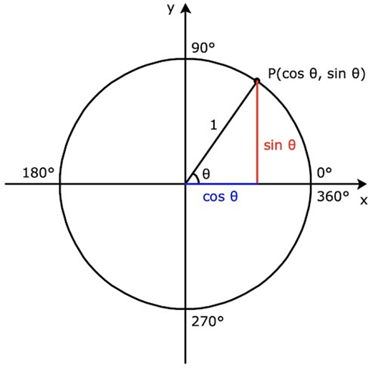
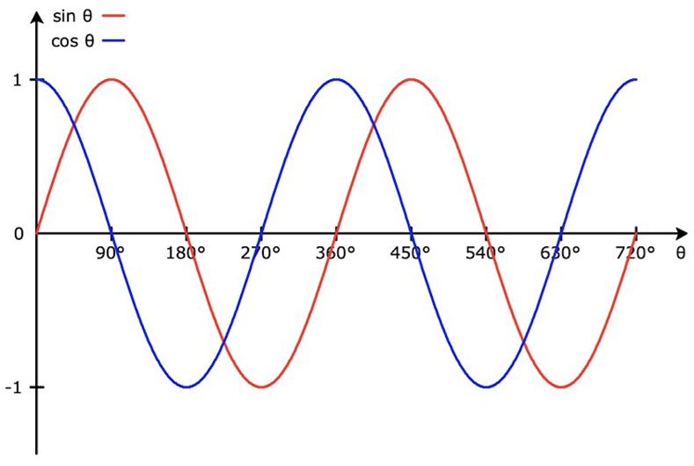
Polarizer: principle
Circular polarization as two linearly polarized waves
Principle of operation
Two orthogonal modes
Phase shift of 90°
Equal amplitudes

Slide 5
Polarizer: state of the art
Dielectric vane polarizers
Wideband operation
High dielectric losses
Iris/corrugated polarizers
Wideband operation
Overmoded structure (mode matching)
Septum polarizers
Dual circular polarization
Complex machining
Other less-popular variants examined in papers

Slide 6
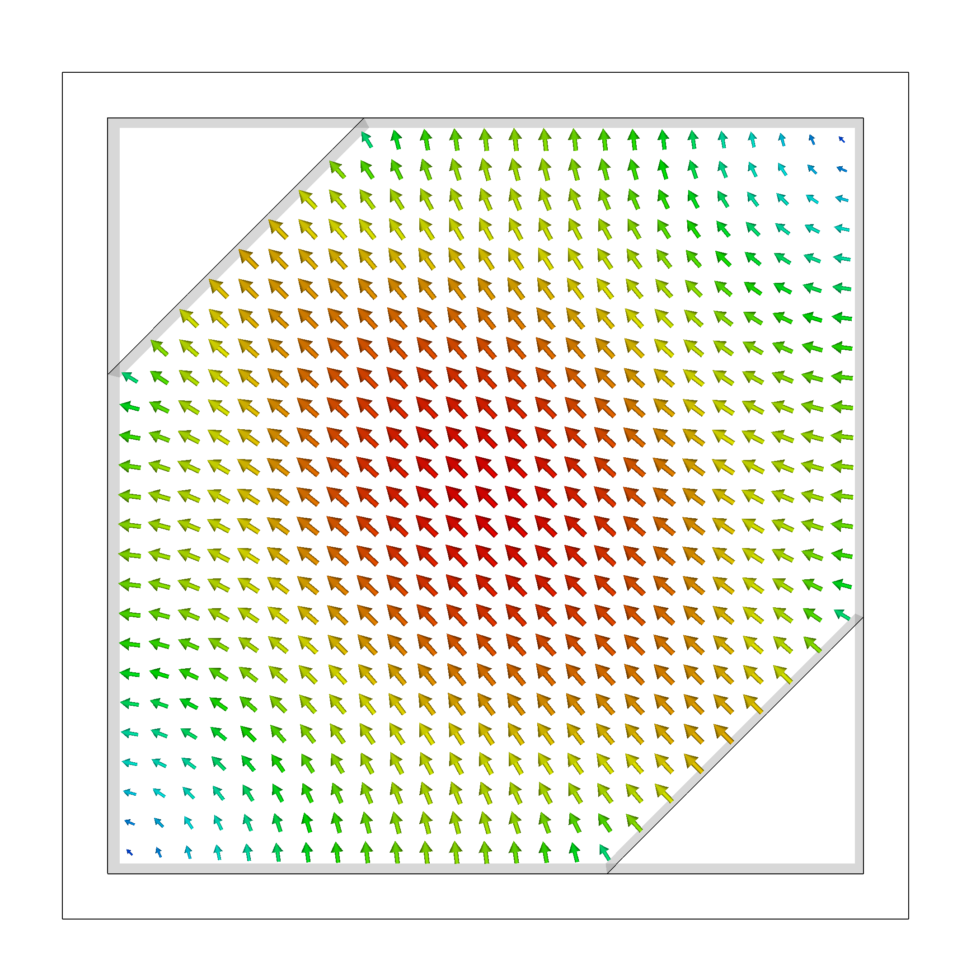
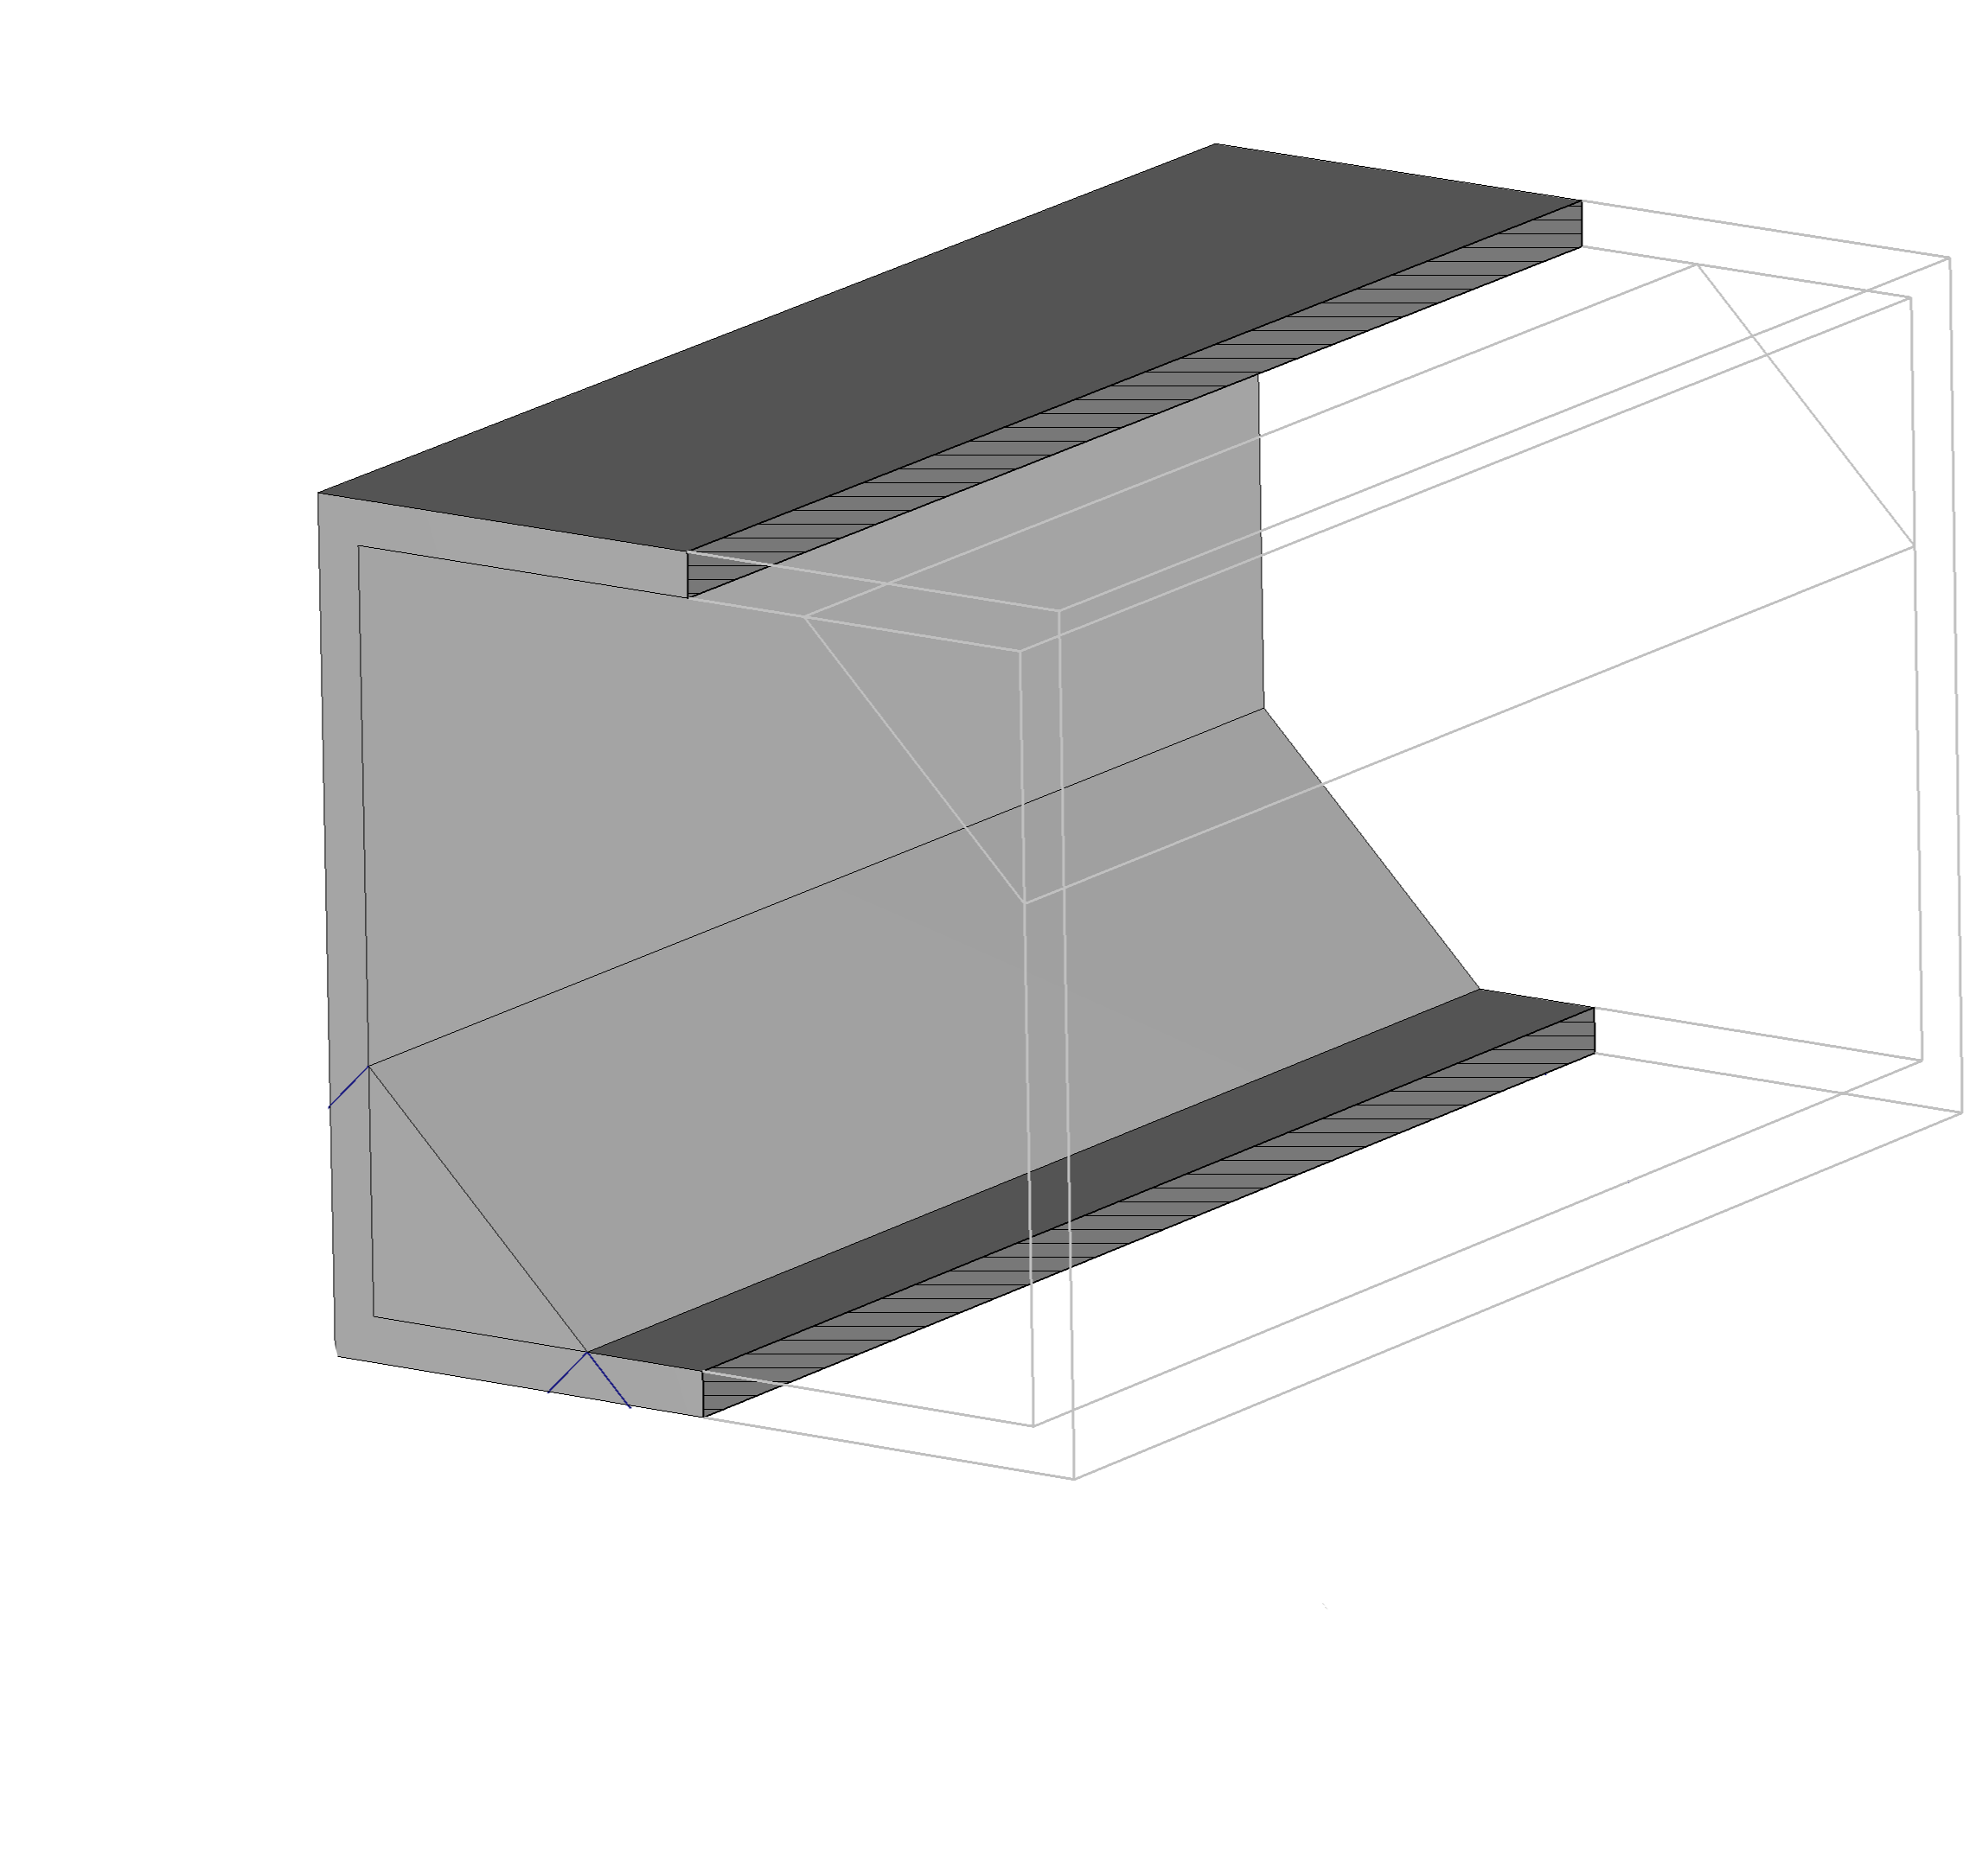
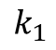
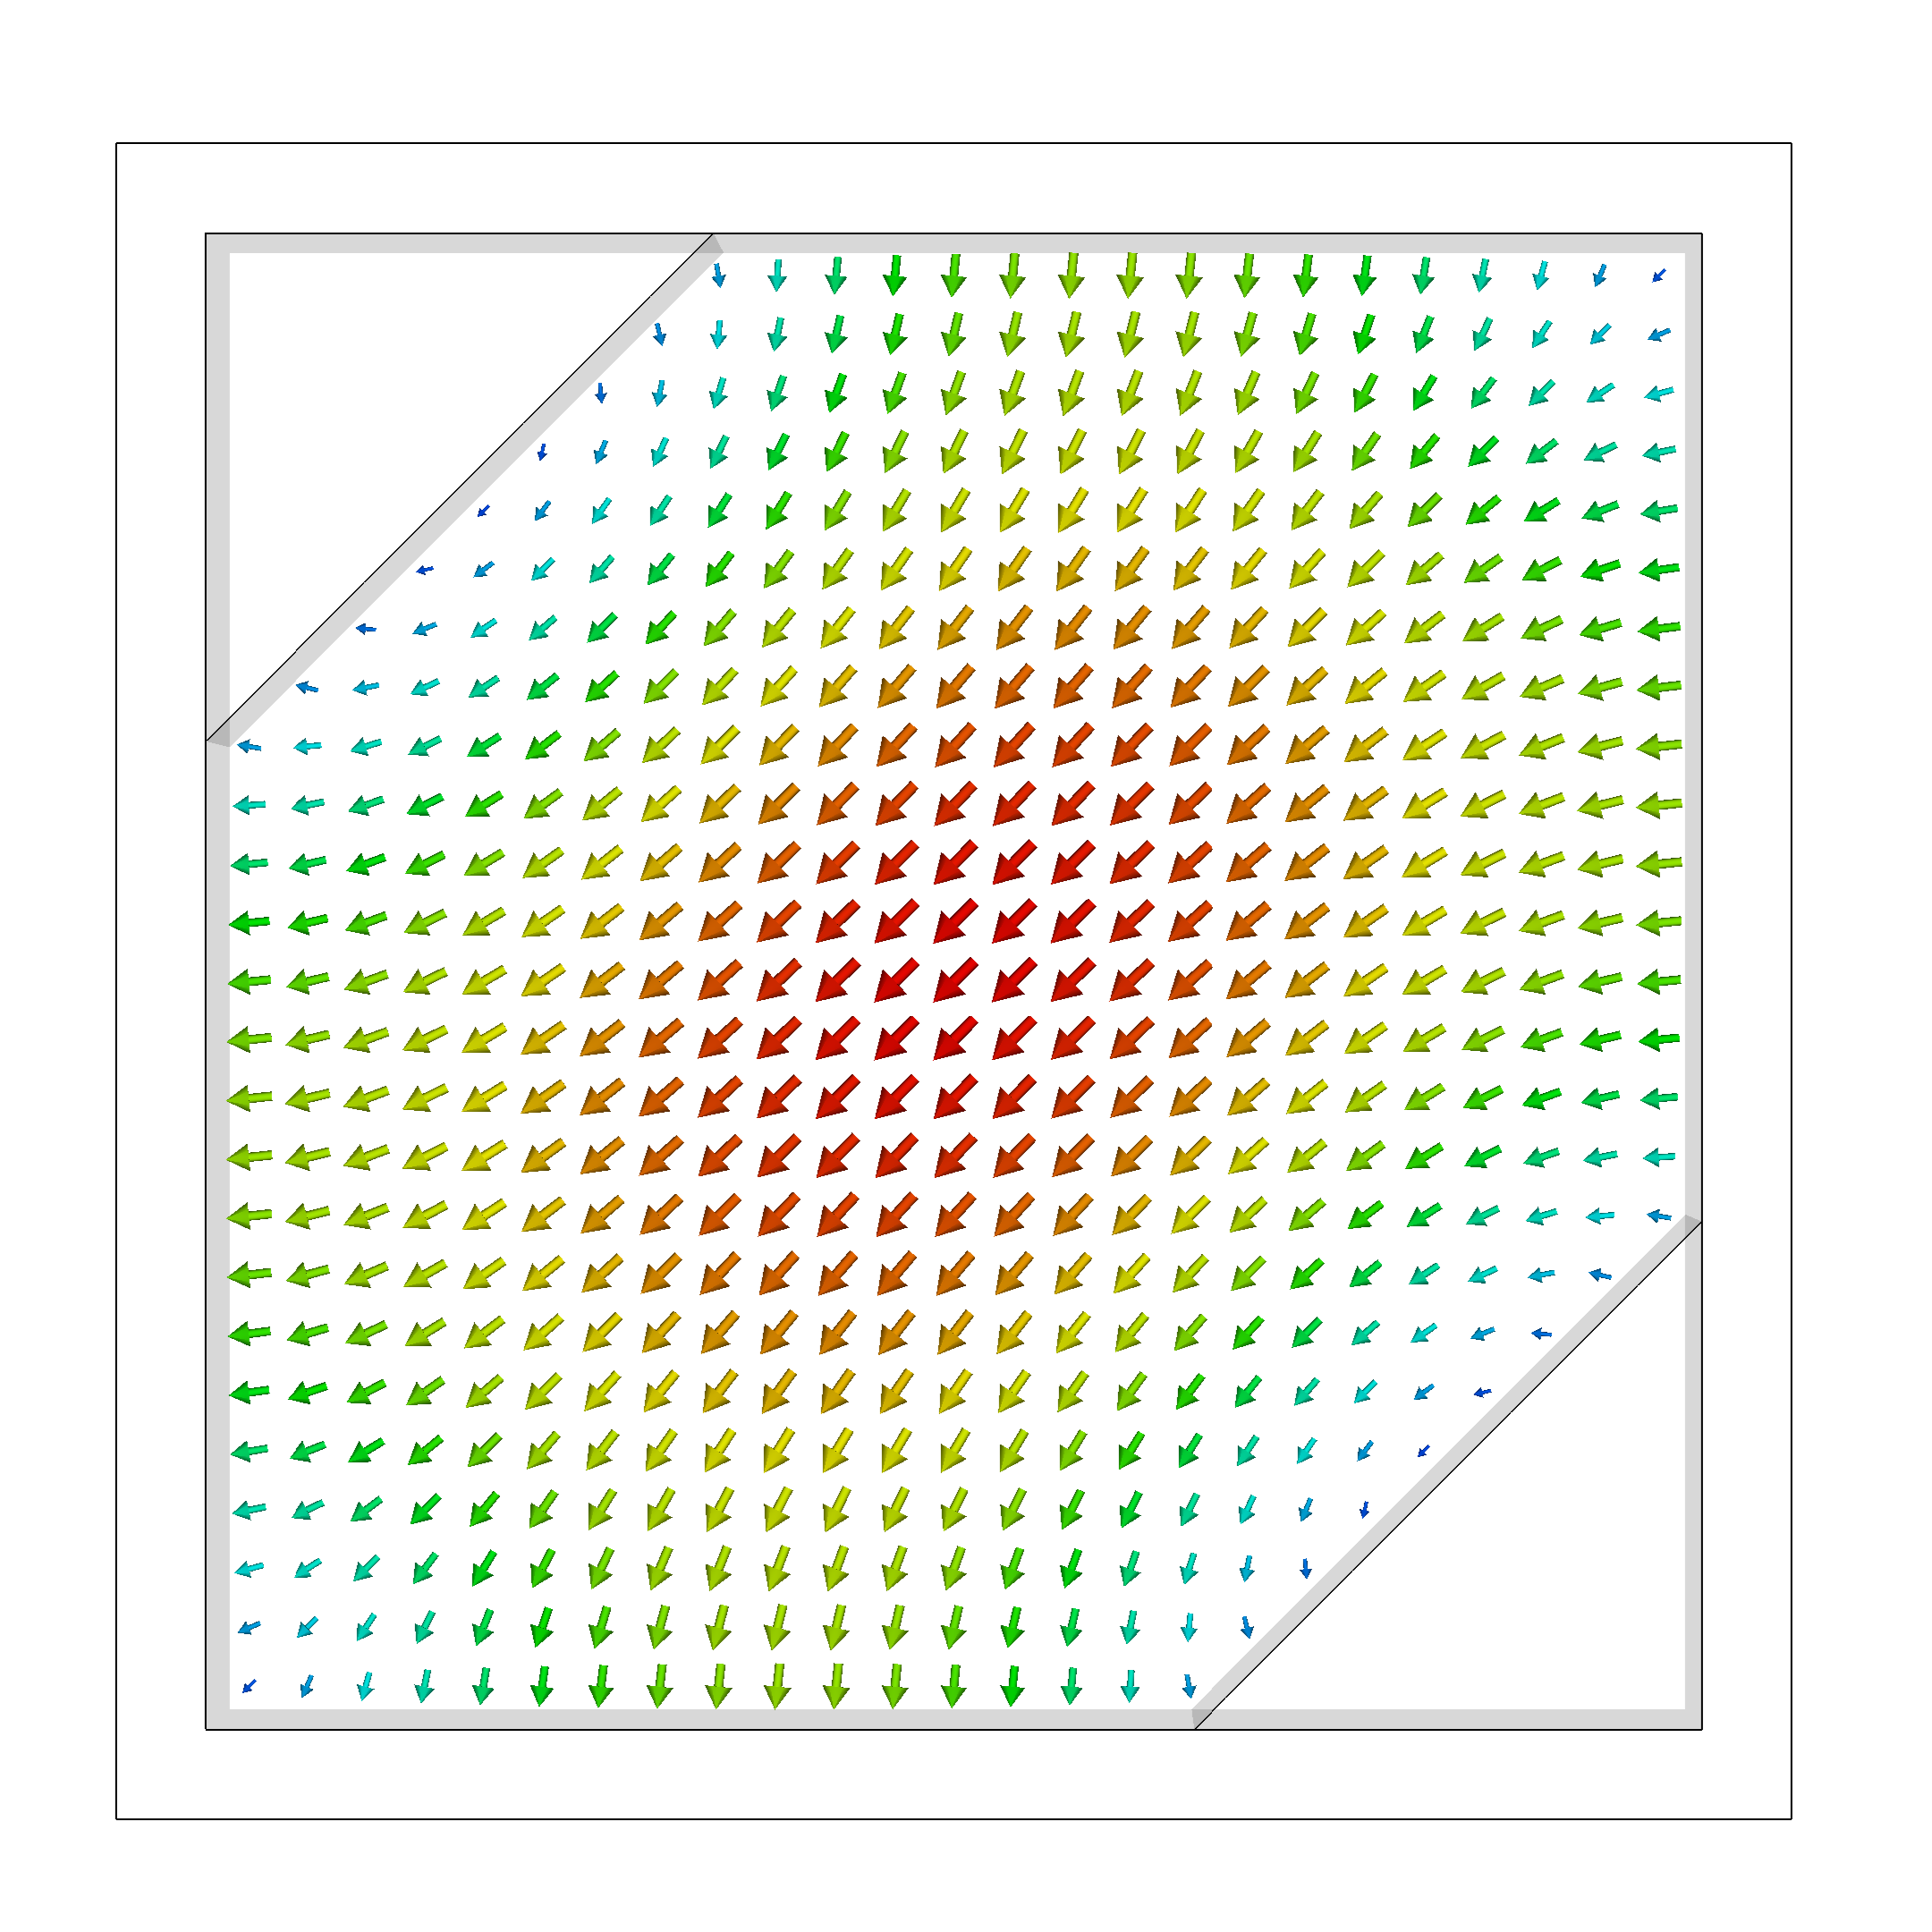
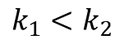
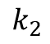
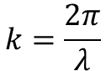
Polarizer: novel approach

Slide 7
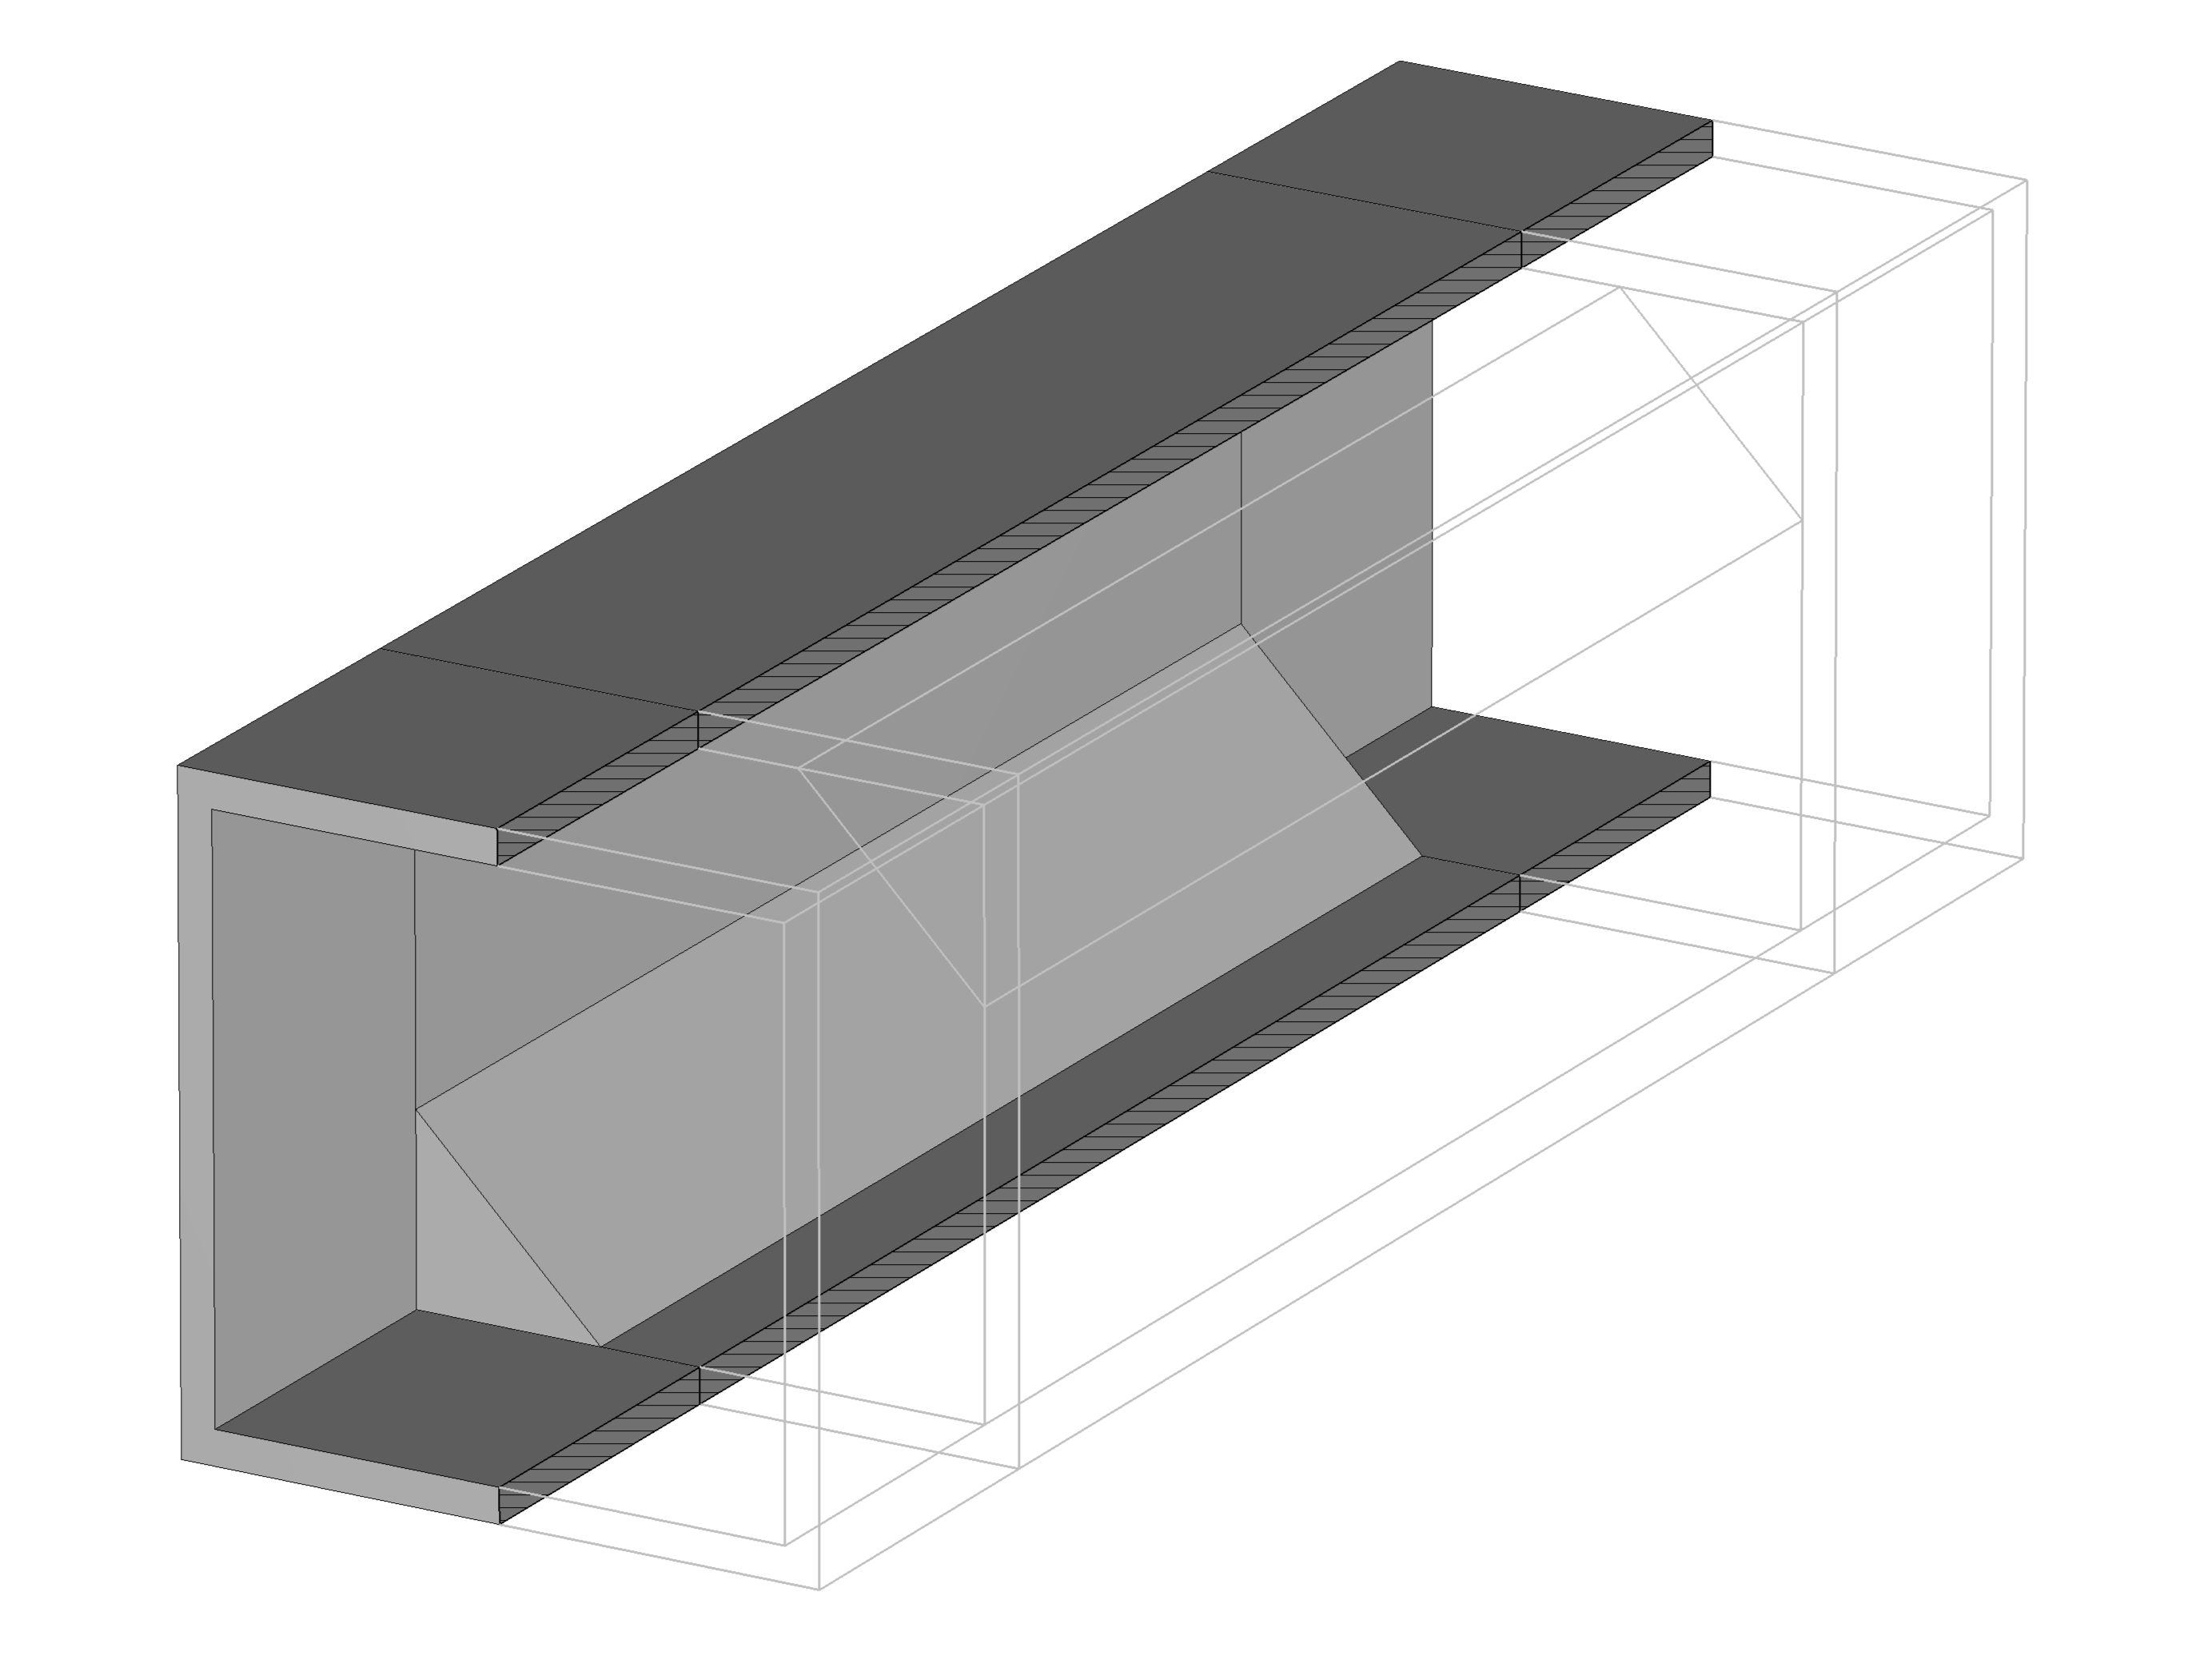
Polarizer: final model

Slide 8
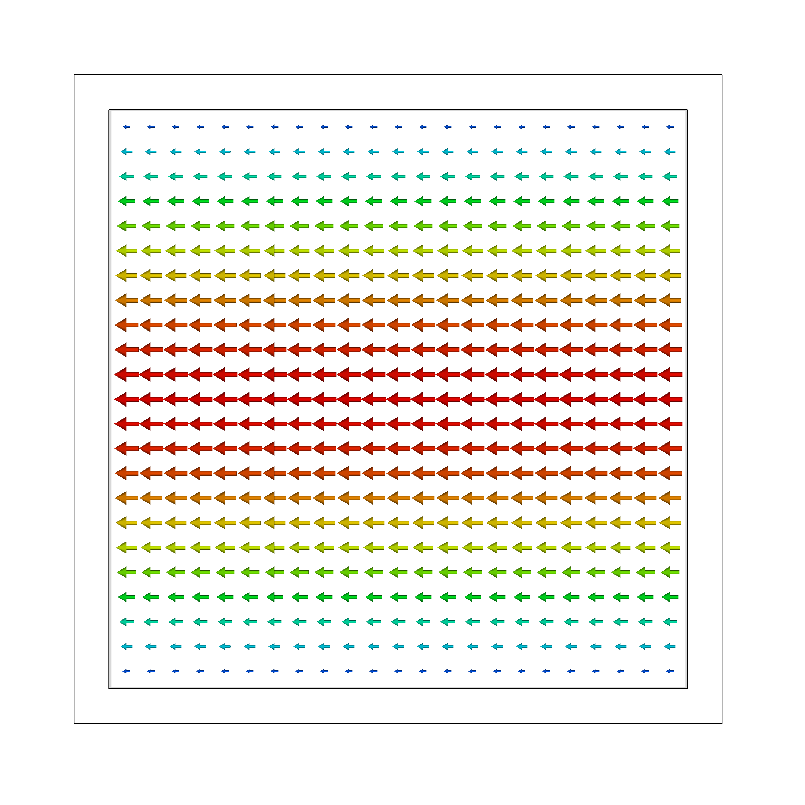
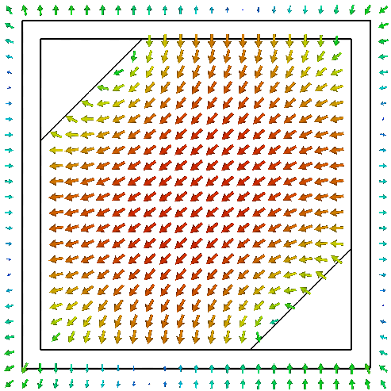
Polarizer: eigenmode analysis

Slide 9
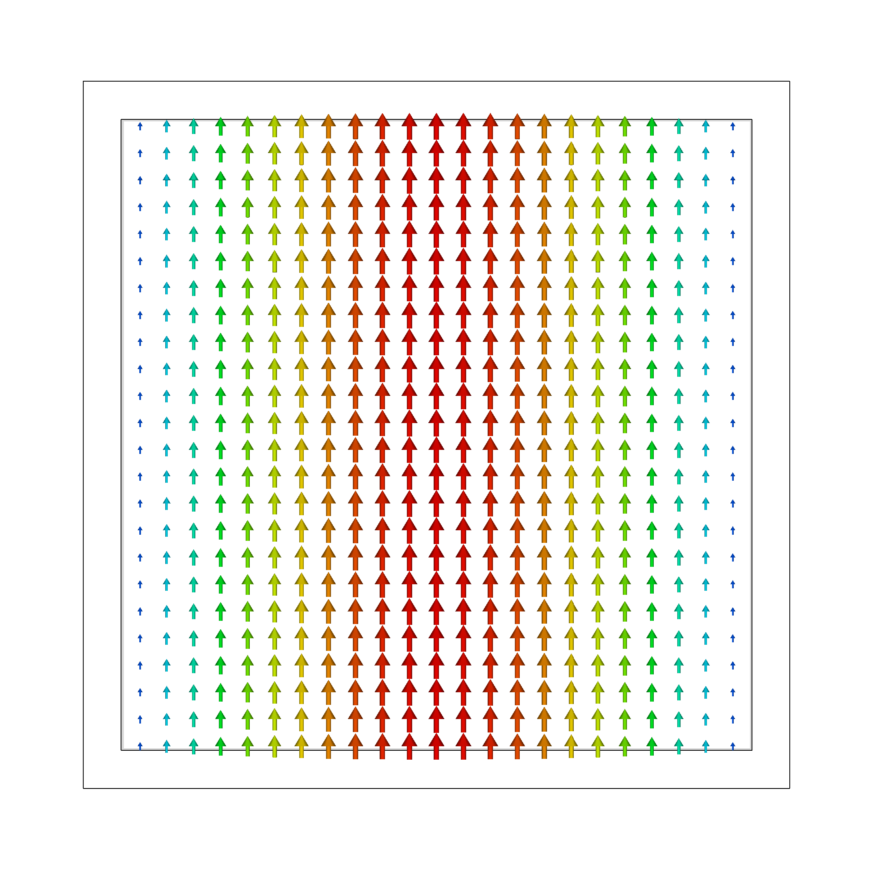
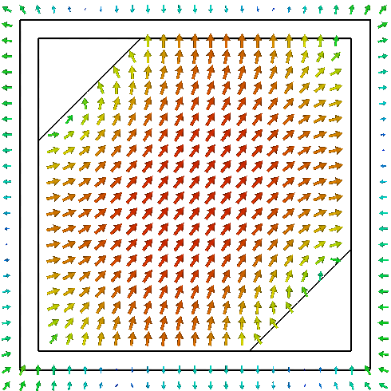
Polarizer: dual polarization

Slide 10
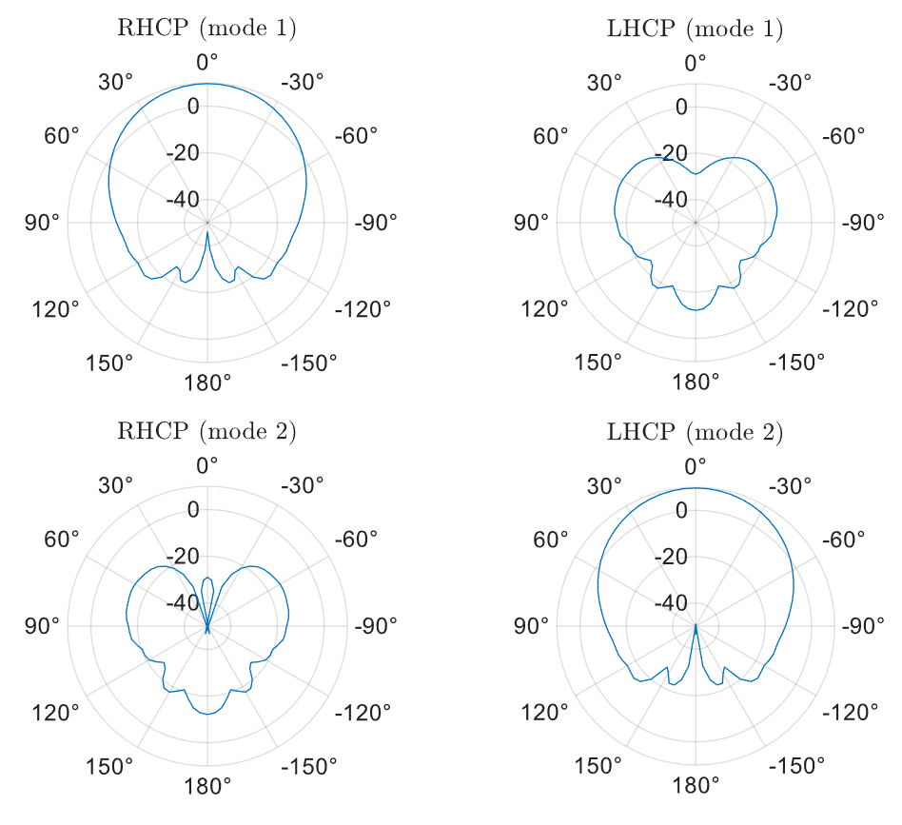
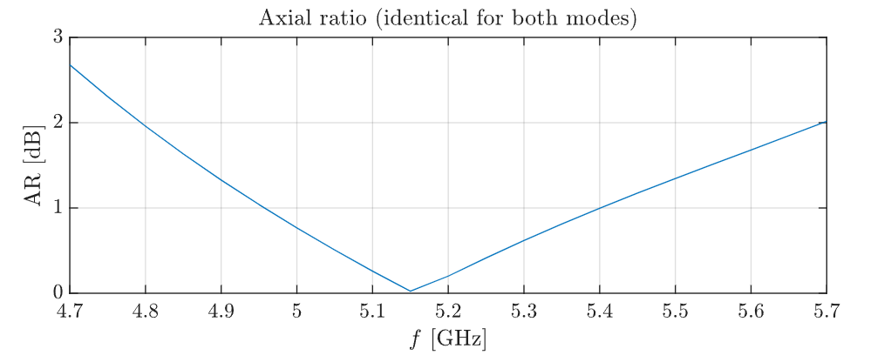
Polarizer: performance
Ease of fabrication
High polarization purity
Dual polarization support

Slide 11
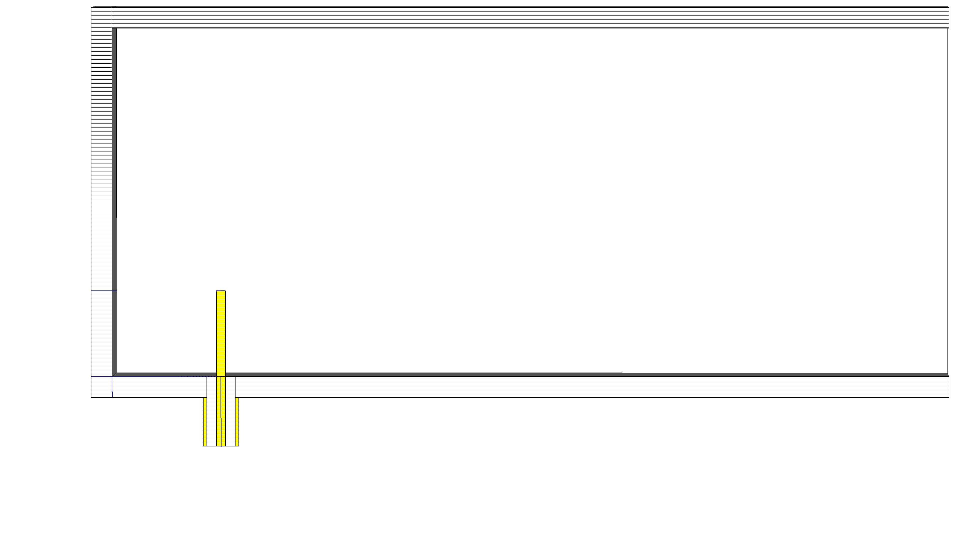
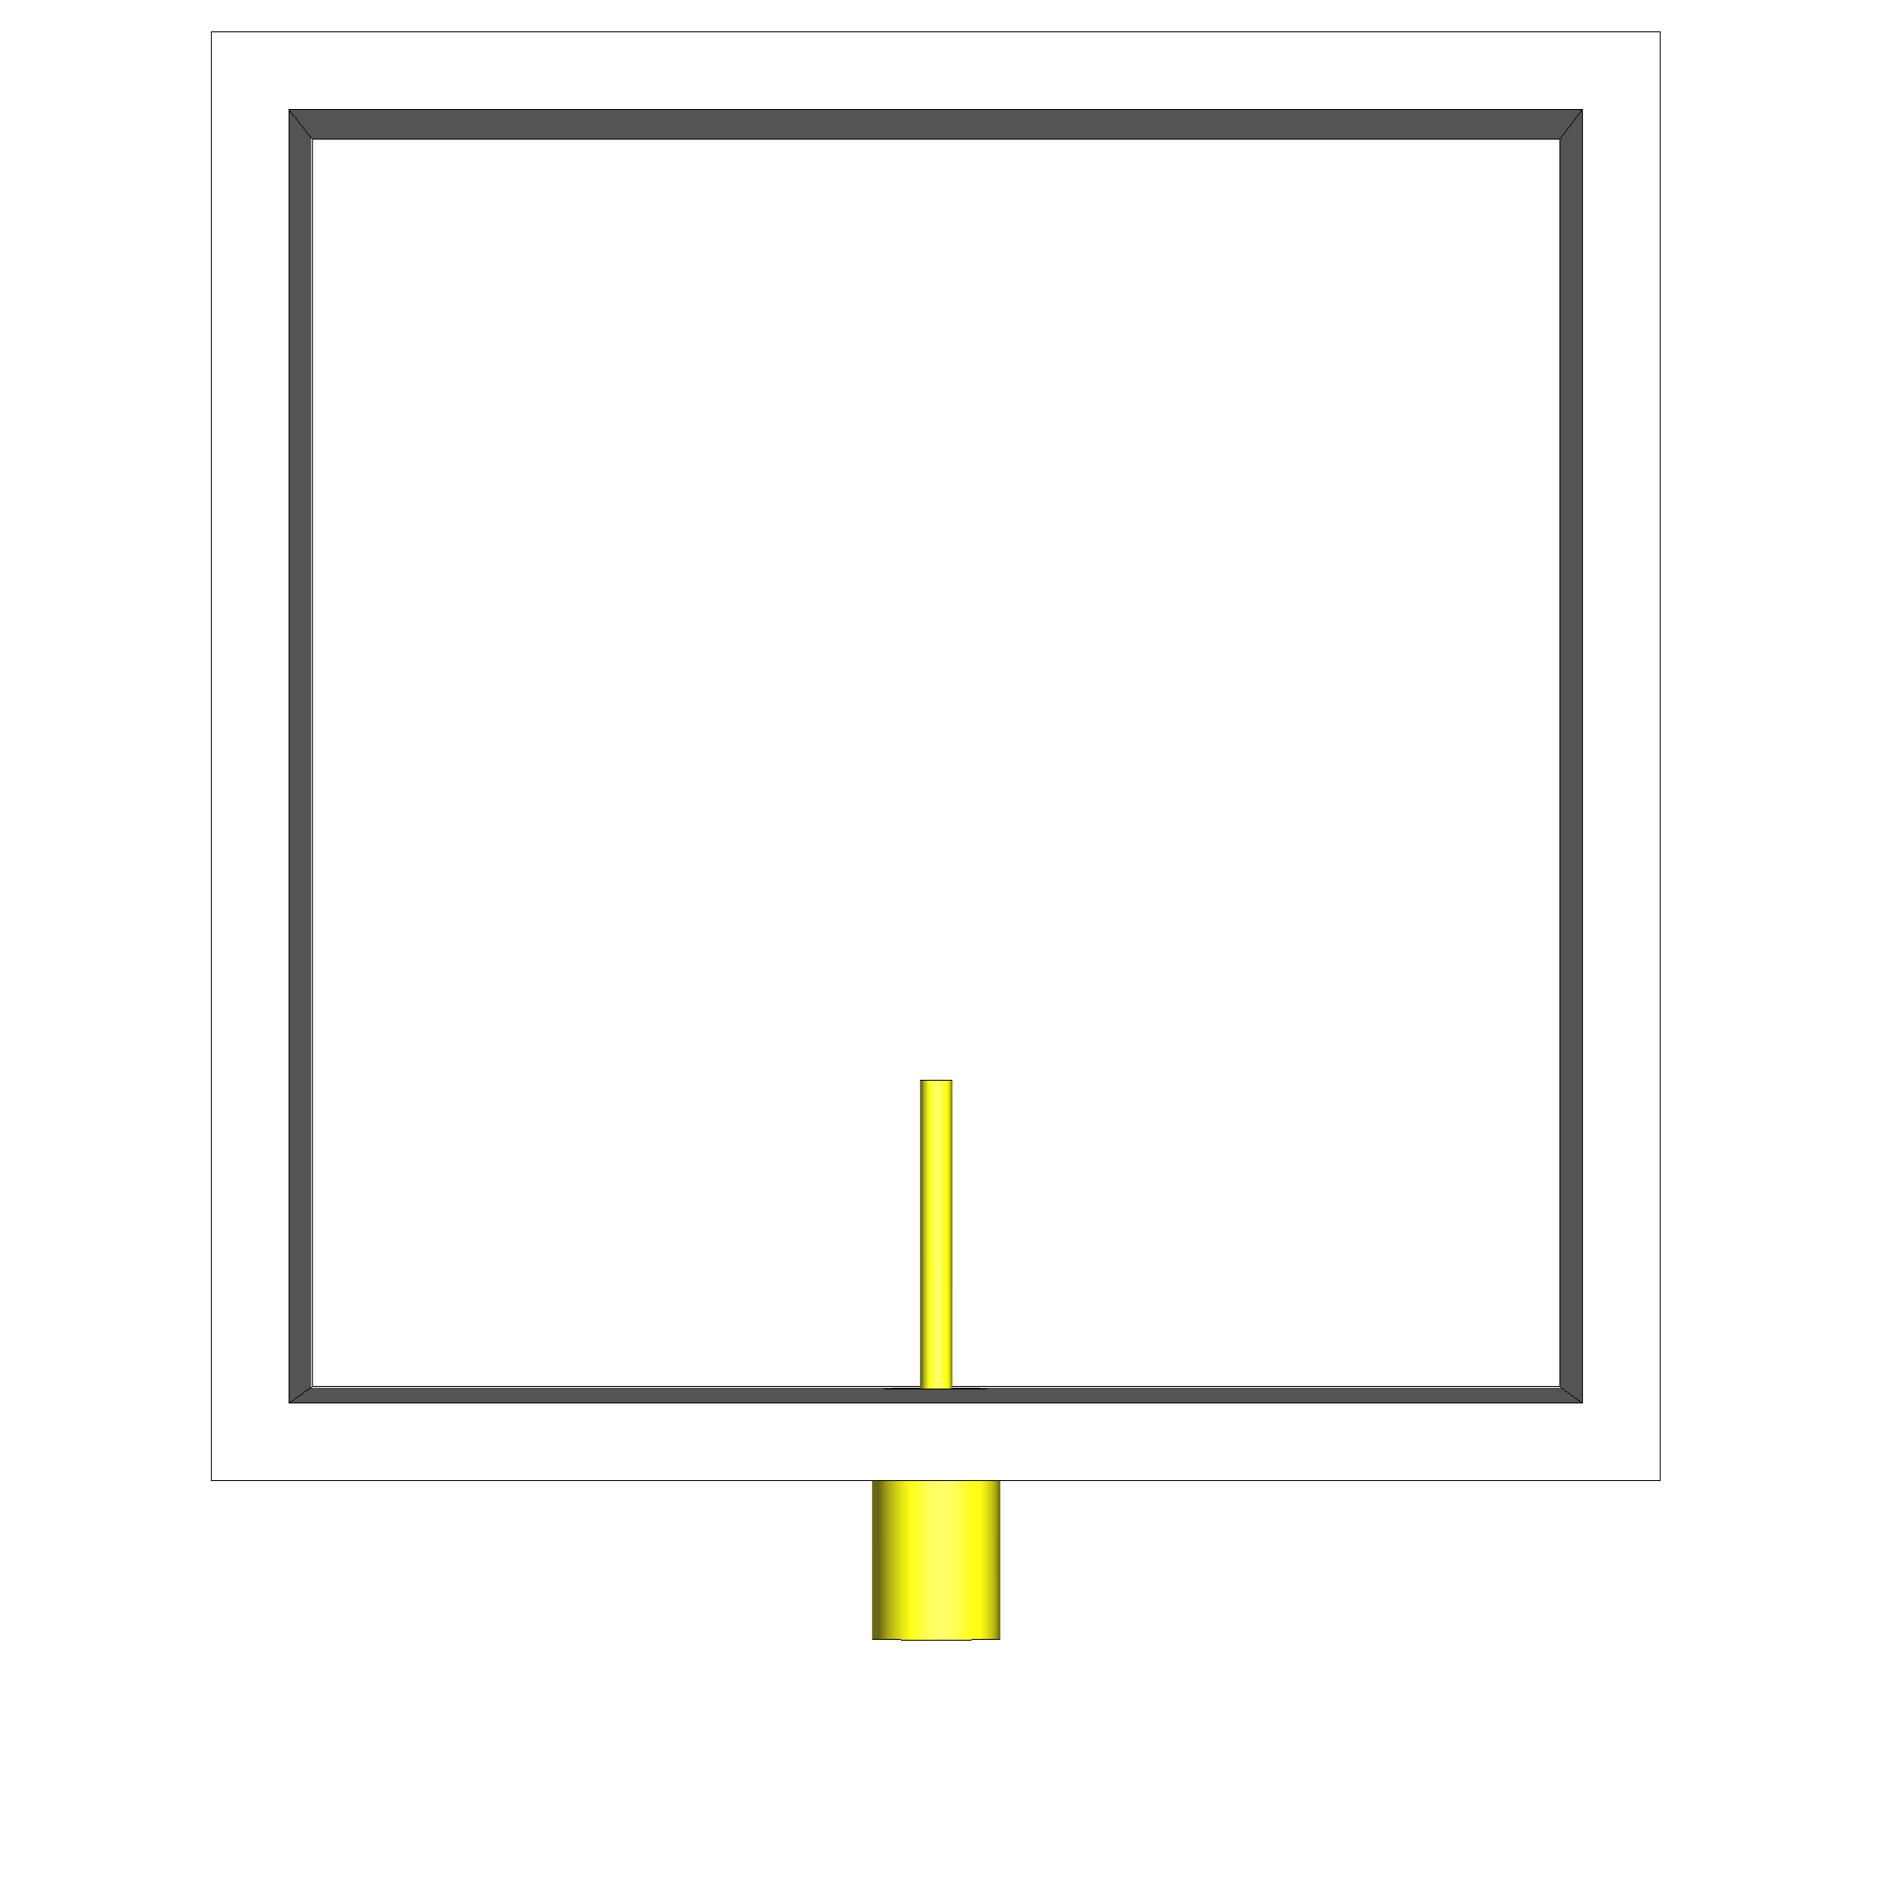
Feeding structure: single feed
Way to excite a waveguide mode
Right-angle coaxial-to-waveguide transition

Slide 12
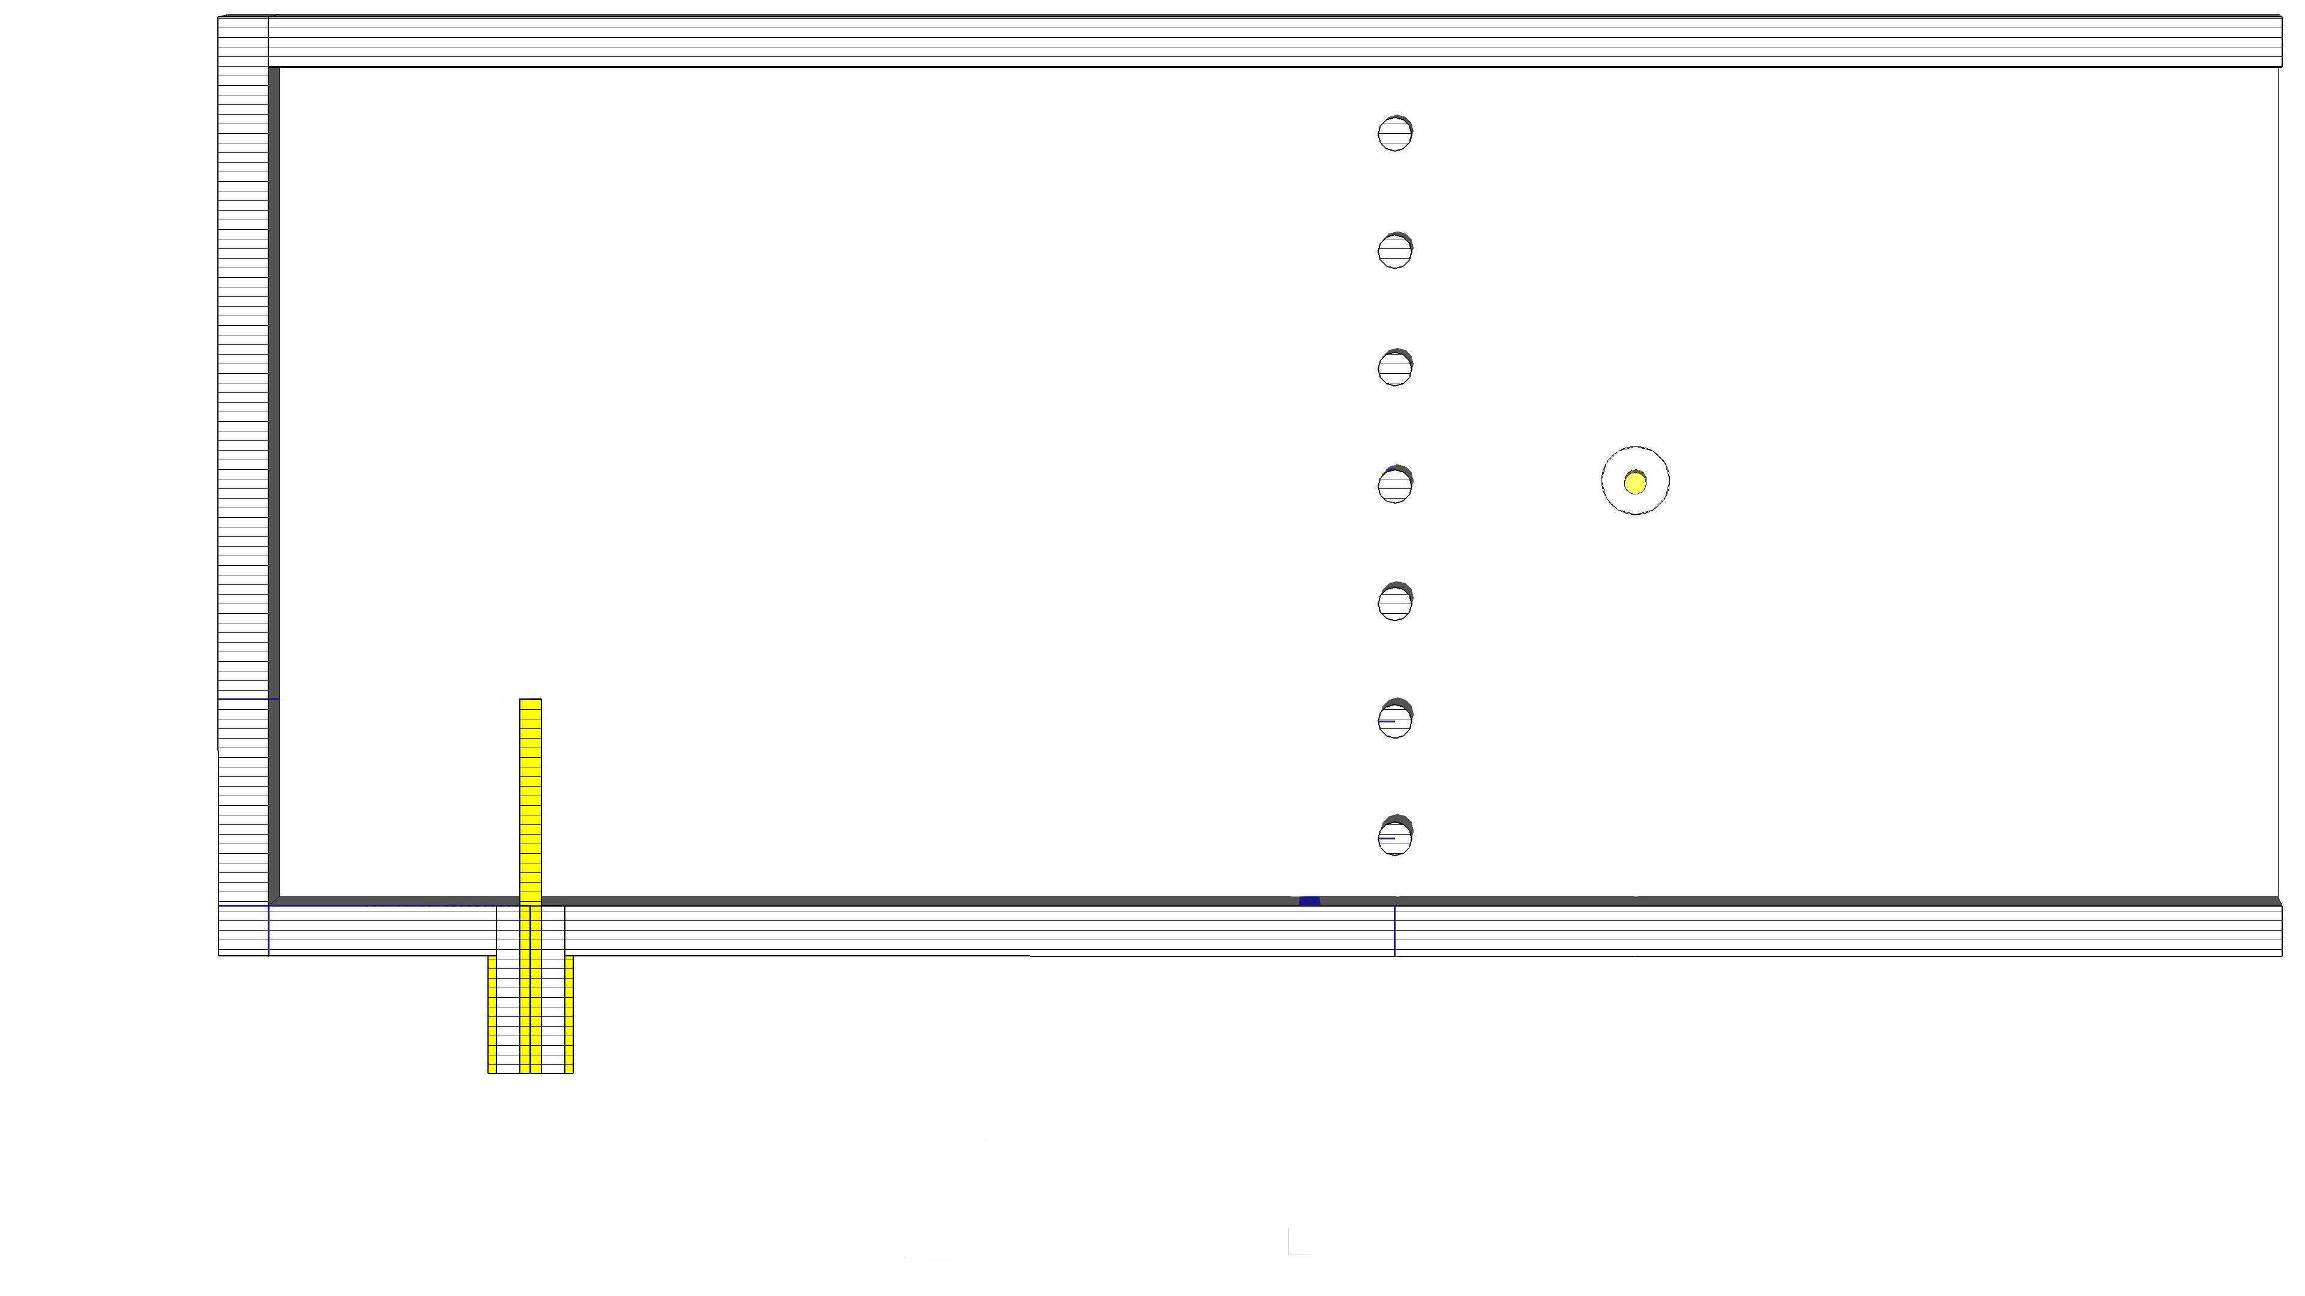
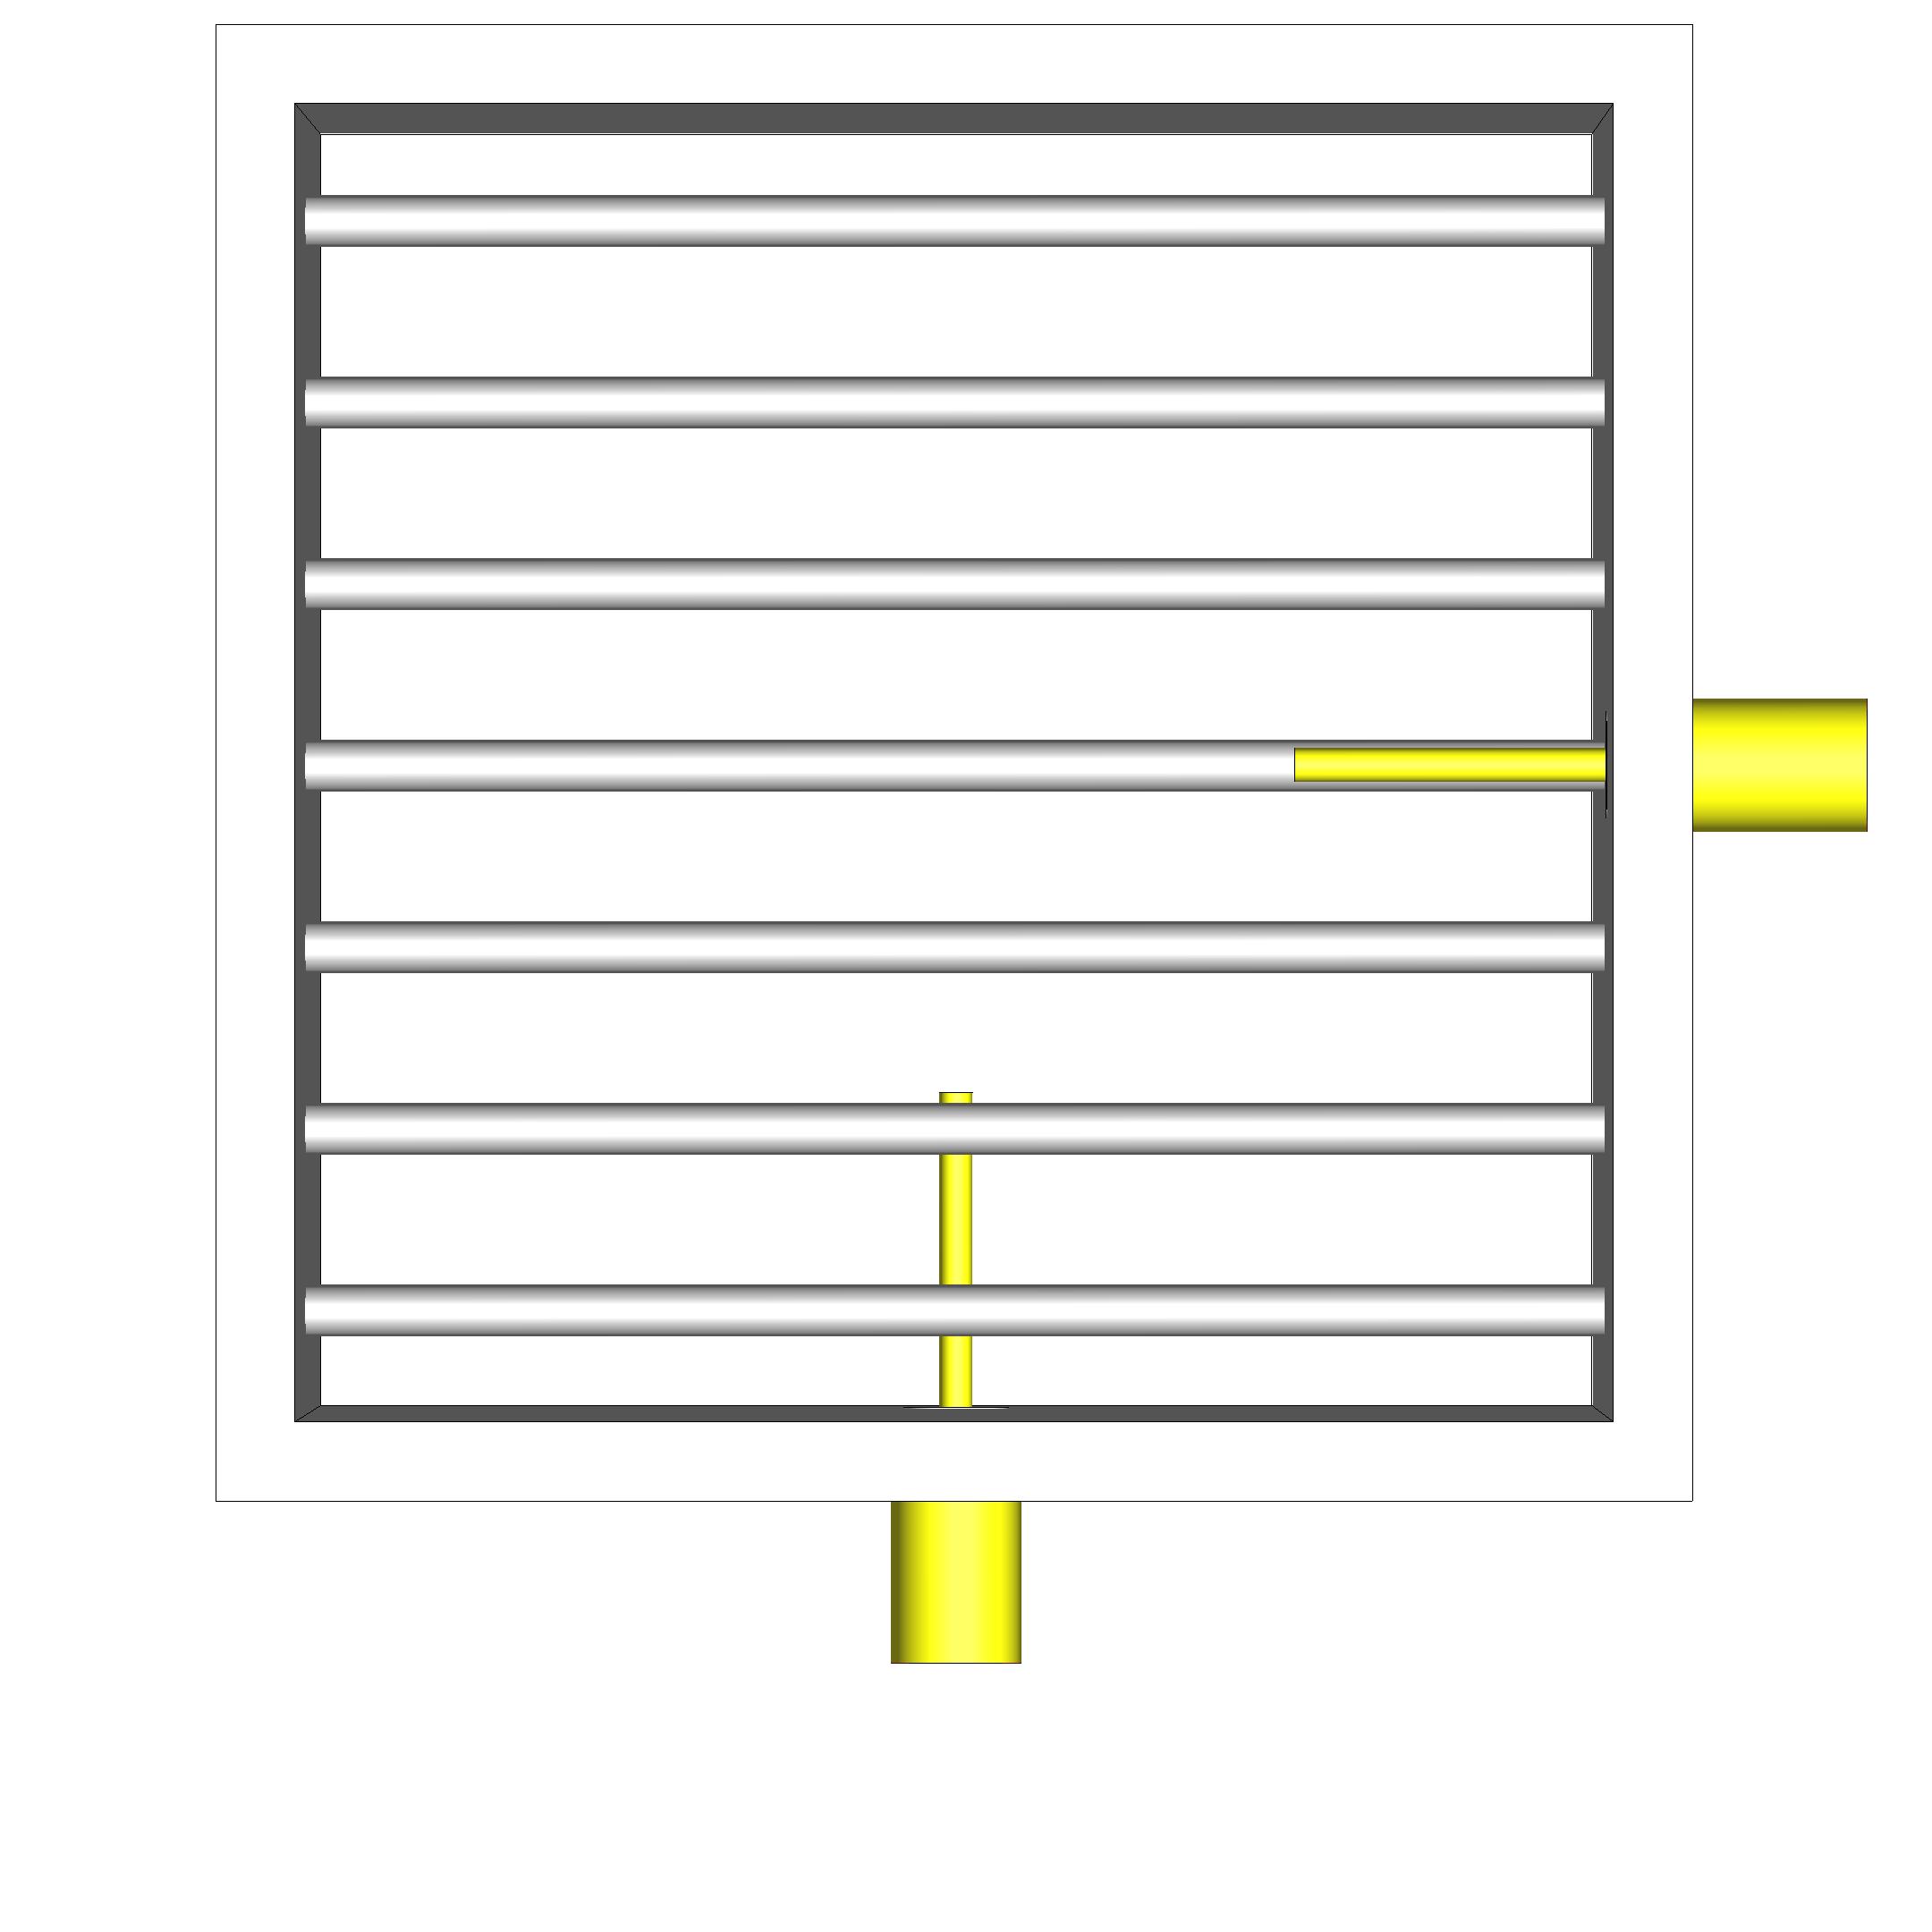
Feeding structure: dual feed
Way to excite both waveguide modes
Grating polarizer allows port separation [26]
Difficult optimization (constrained algorithm)

Slide 13
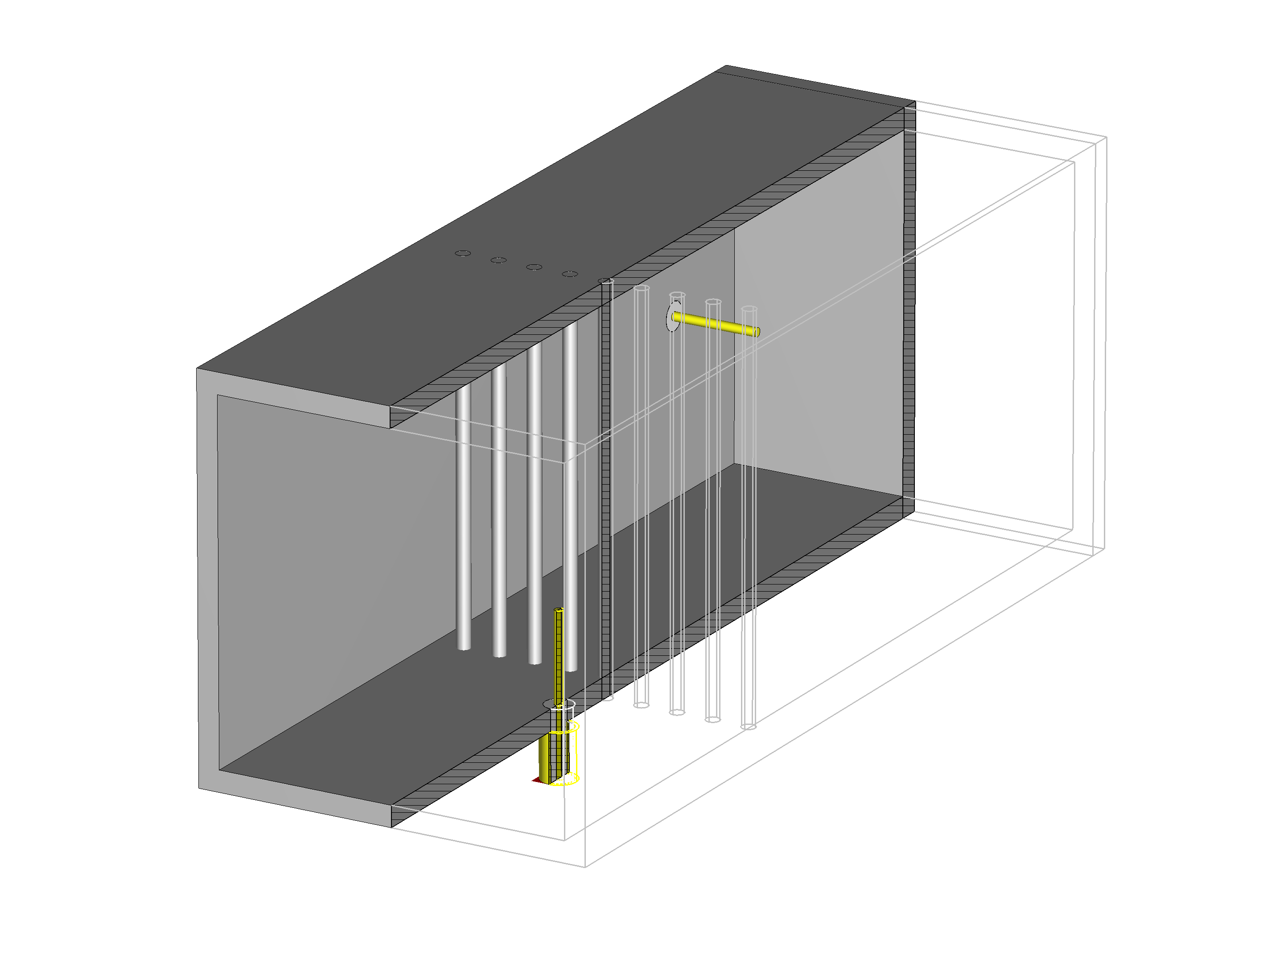
Feeding structure: final model

Slide 14
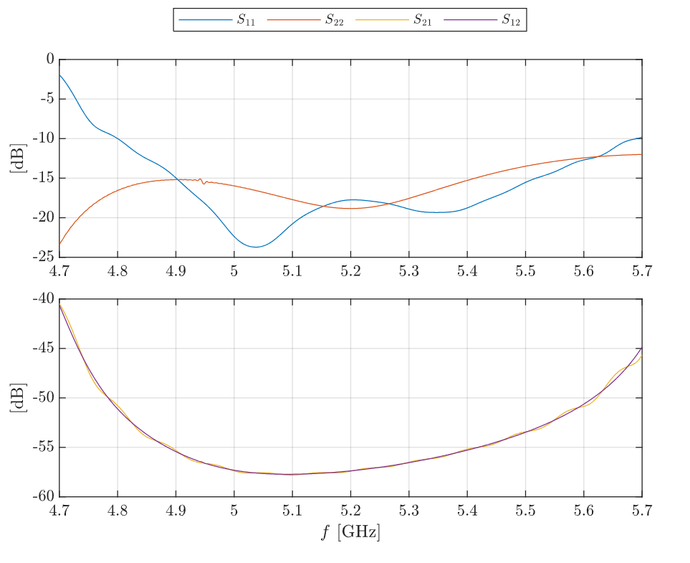
Feeding structure: performance

Slide 15
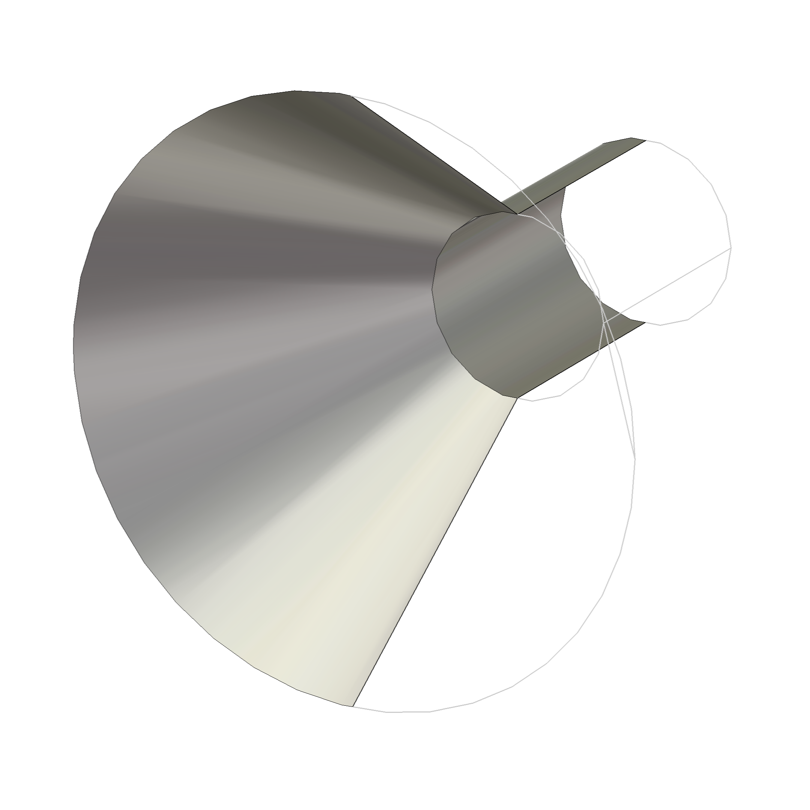
Antenna
Smooth impedance transformation
Directional gain, target 15 dBi
Conical horn
Antenna Magus

Slide 16
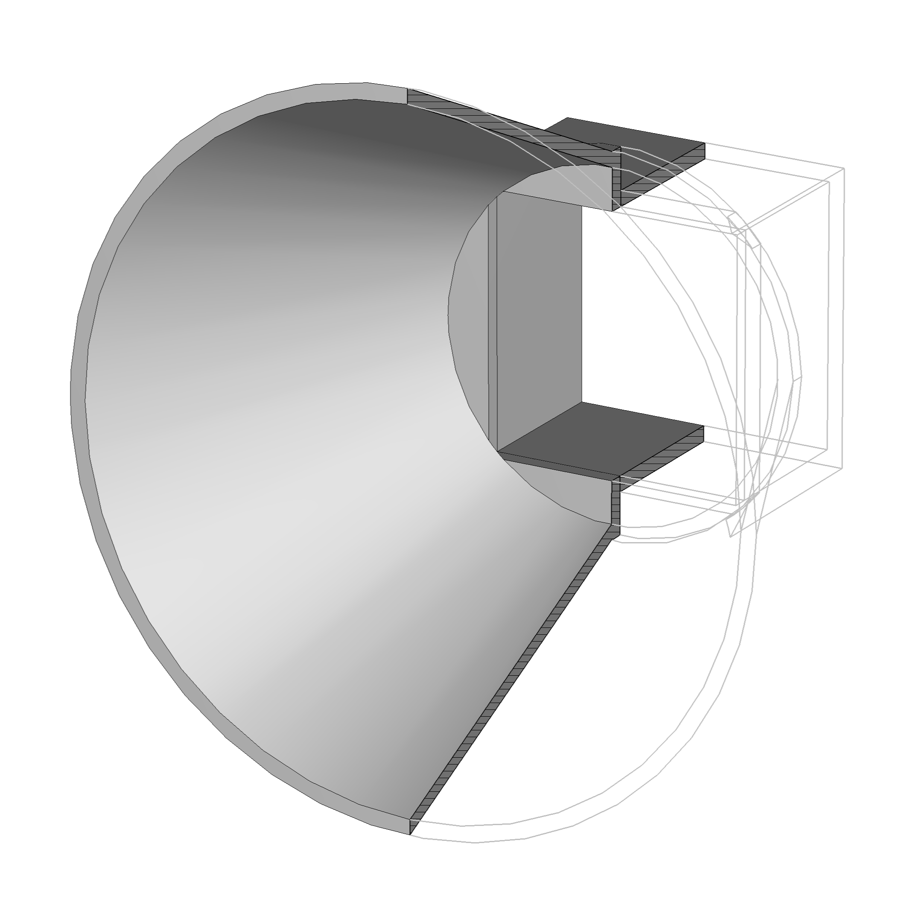
Antenna: final model

Slide 17
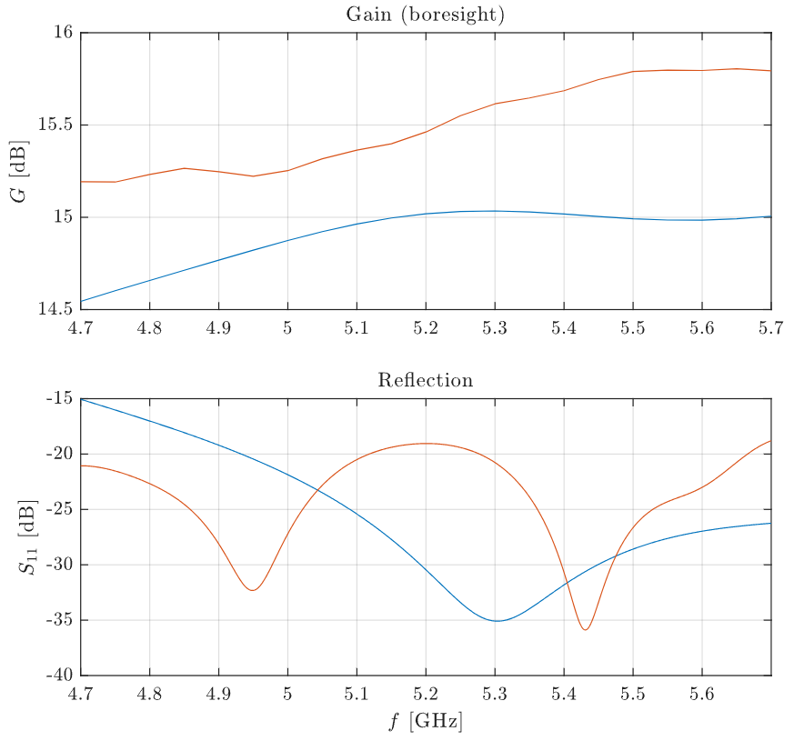
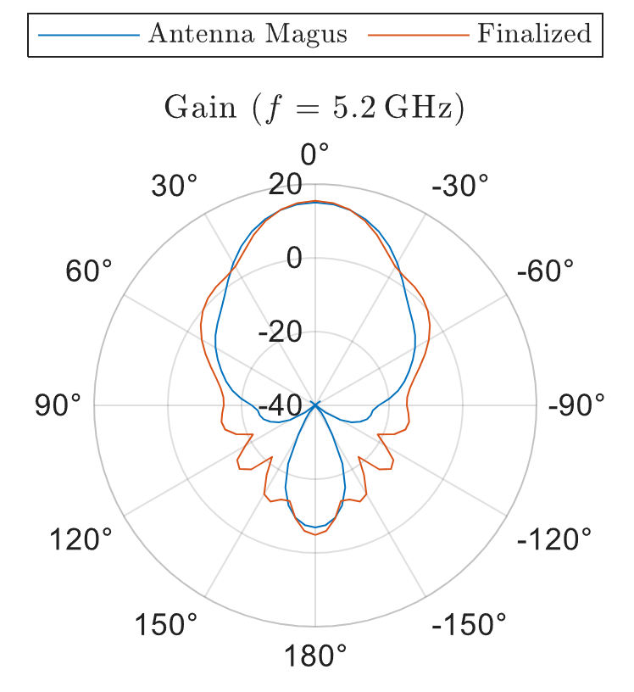
Antenna: performance

Slide 18
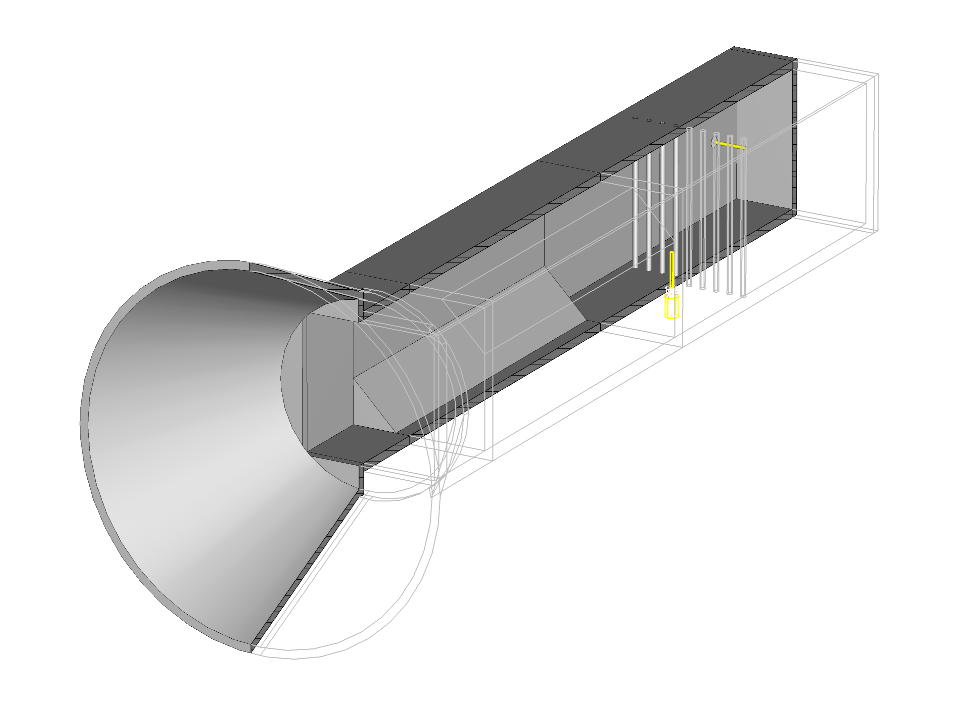
Final structure: initial assembly

Slide 19
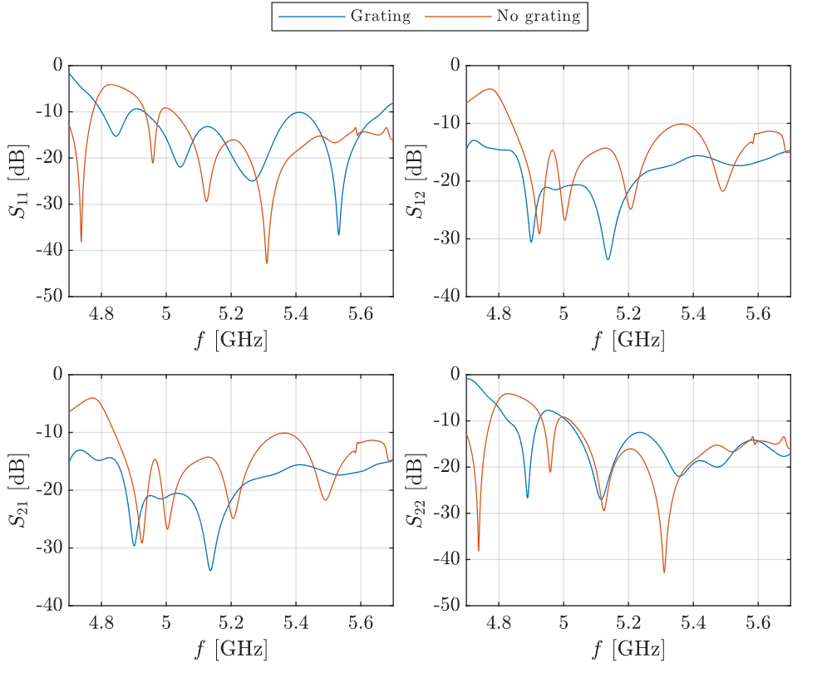
Final structure: grating issue

Slide 20
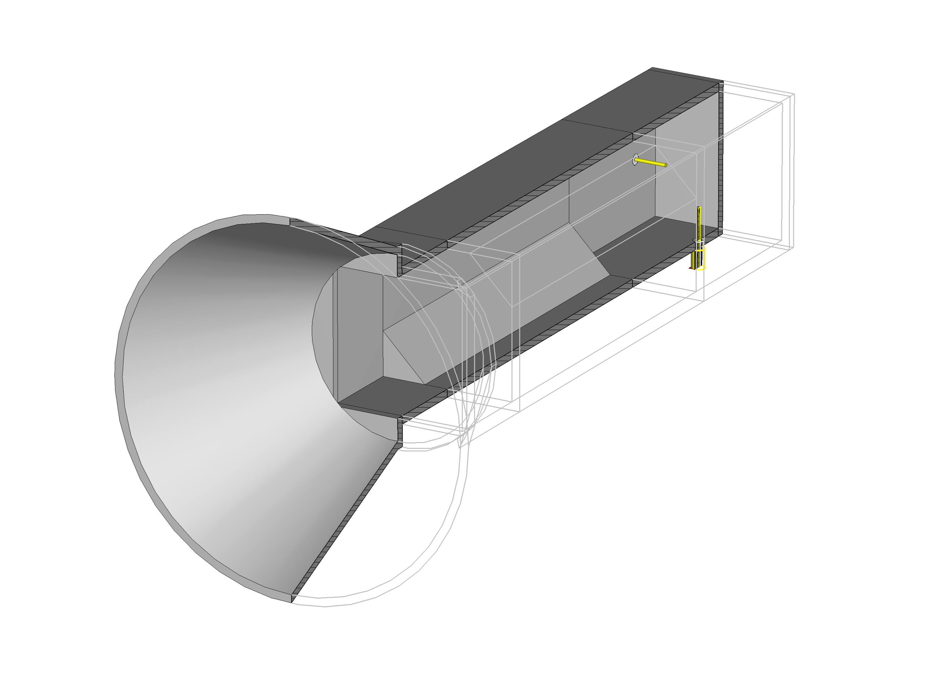
Final structure: feed rework

Slide 21
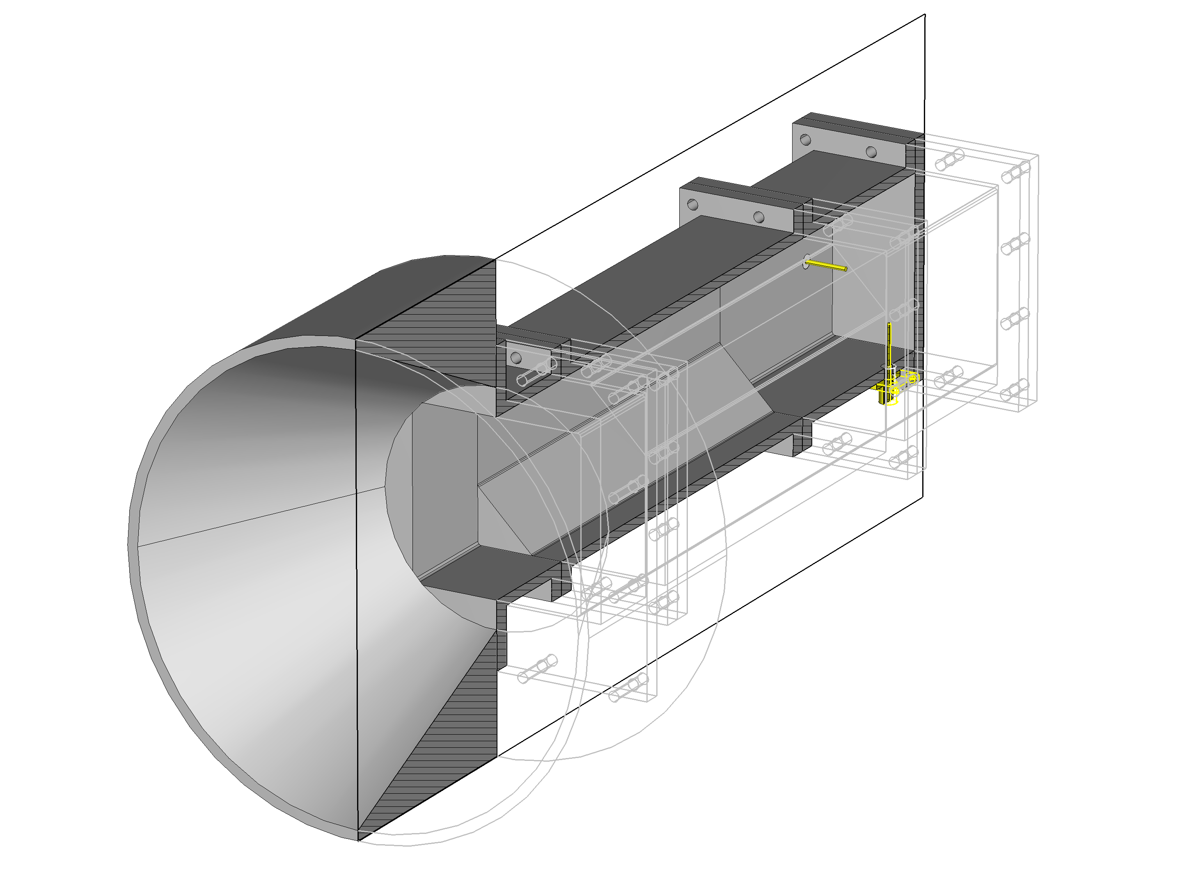
Final structure: DFM

Slide 22
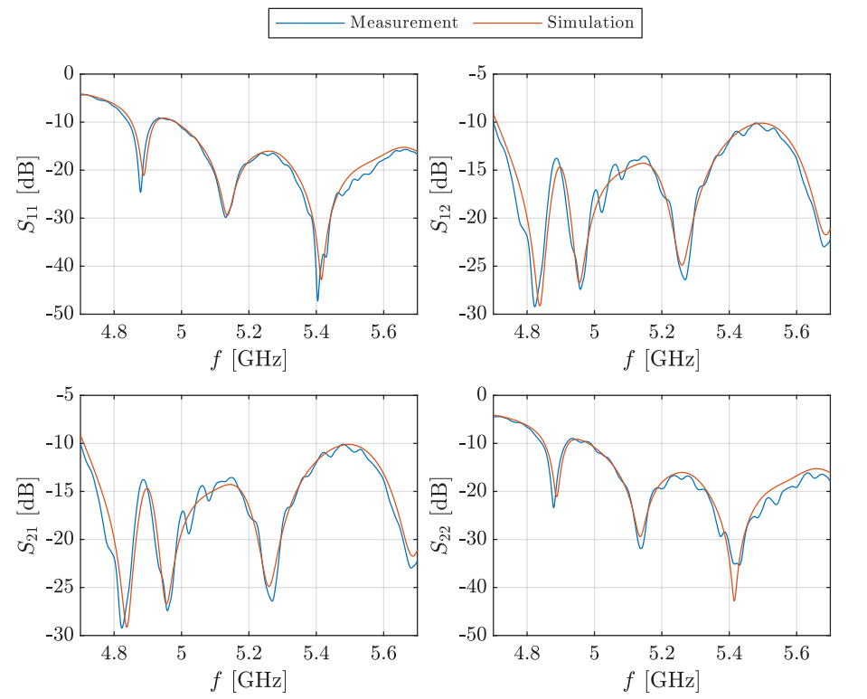
Measurement: S-parameters

Slide 23
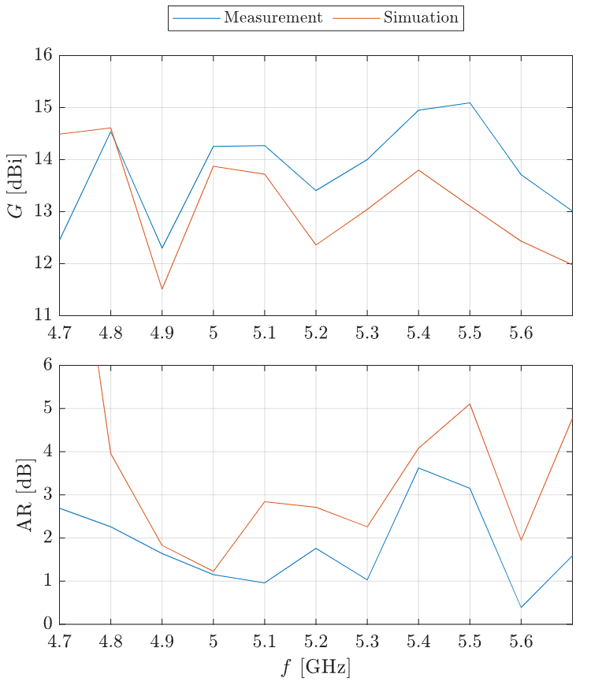
Measurement: boresight radiation

Slide 24
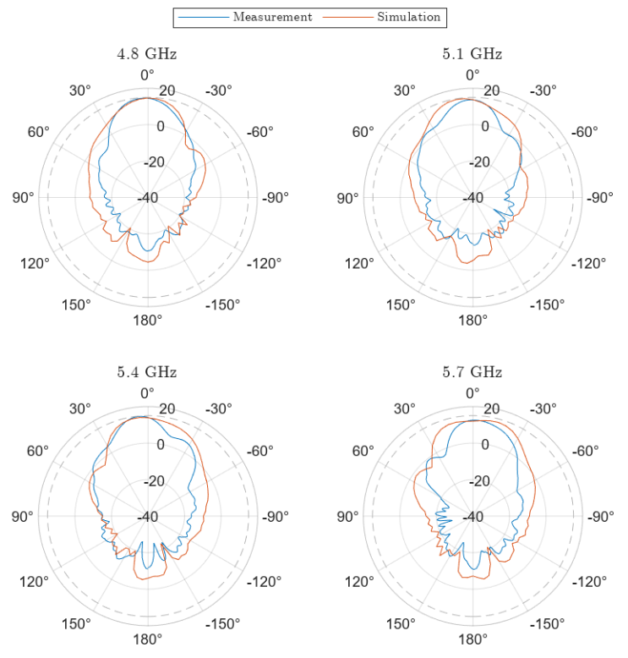
Measurement: elevation pattern

Slide 25
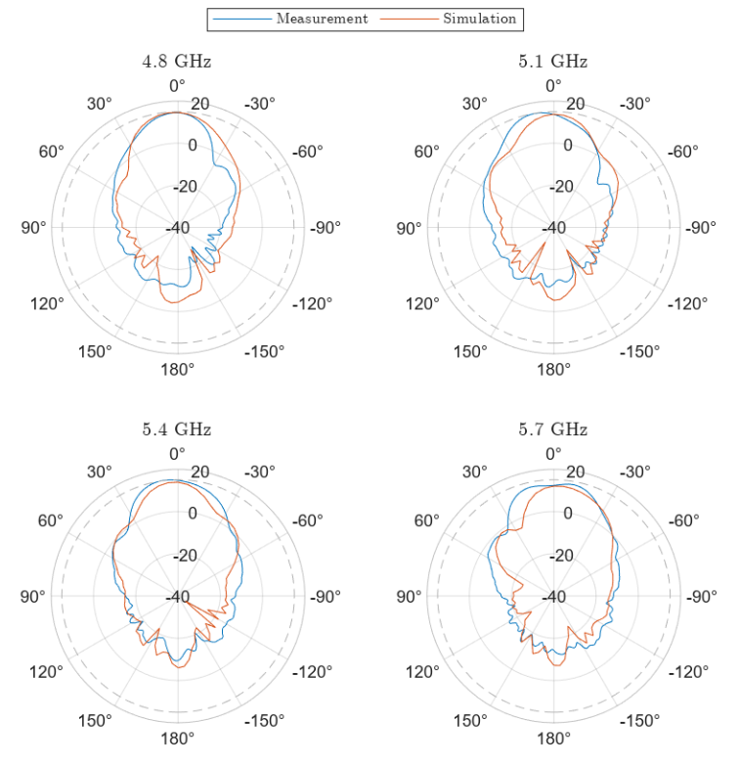
Measurement: azimuth pattern

Slide 26
Conclusion
Novel polarizer based on simple geometry
Switchable dual polarization capability
Functionality demonstrated in a complete system
Functional prototype fabricated
Simulation data confirmed by measurement
All objectives achieved with academic rigour

Slide 27
Thank you
for your attention

Slide 28
Reaction
to opponent’s questions

Slide 29
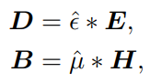
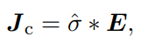
Question #1
In the explanation of relations 1.3 and 1.4, you talk about convolution. What exactly do you mean by that?
General materials can exhibit:
Anisotropy
Inhomogeneity
Dispersion
Convolution reflects linearity and time-causality
Materials can also be non-linear
Volterra series
Numerical methods
Perturbation theory

Slide 30
Question #2
Could you please explain the optimization described from page 35 onwards in more detail?
Three-phase optimization process of the dual feed
Single right-angle transition
Grating position
Second feed

Slide 31
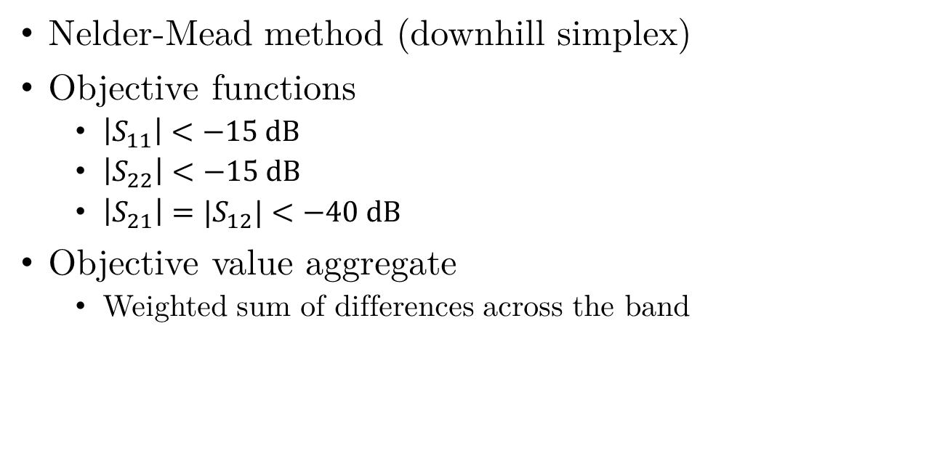
Question #2
Could you please explain the optimization described from page 35 onwards in more detail?
Nelder-Mead method (downhill simplex)
Objective functions
$\left|S_{11}\right|<−15 dB$
$\left|S_{22}\right|<−15 dB$
$\left|S_{21}\right|=|S_{12}|<−40 dB$
Objective value aggregate
Weighted sum of differences across the band

Slide 32
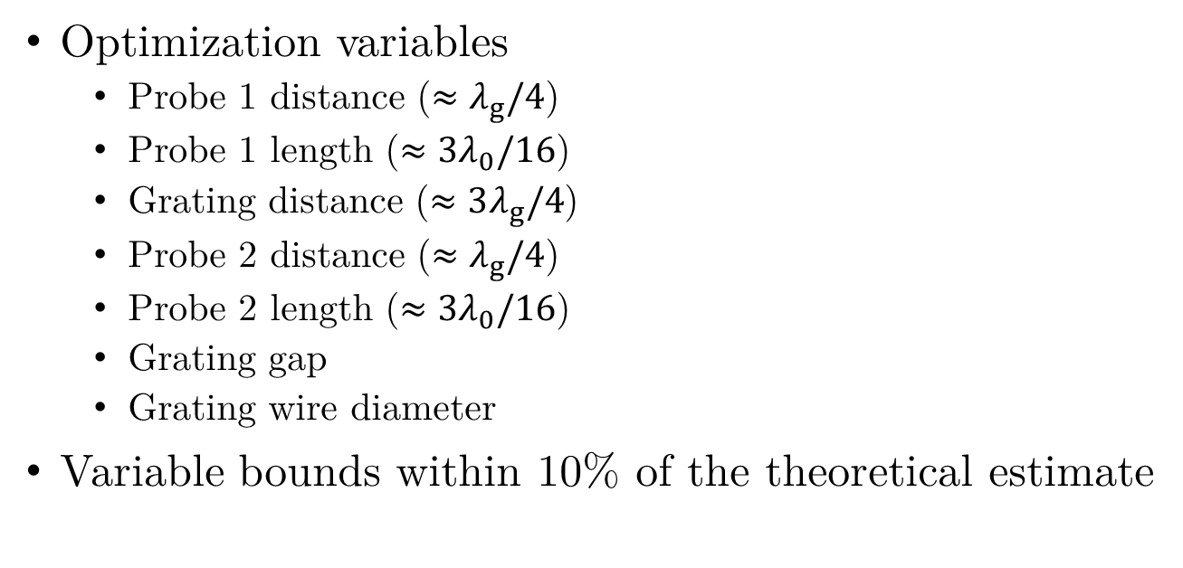
Question #2
Could you please explain the optimization described from page 35 onwards in more detail?
Optimization variables
Probe 1 distance ($≈λ_{g}/4$)
Probe 1 length ($≈3λ_{0}/16$)
Grating distance ($≈3λ_{g}/4$)
Probe 2 distance ($≈λ_{g}/4$)
Probe 2 length ($≈3λ_{0}/16$)
Grating gap
Grating wire diameter
Variable bounds within 10% of the theoretical estimate

